Slide 1
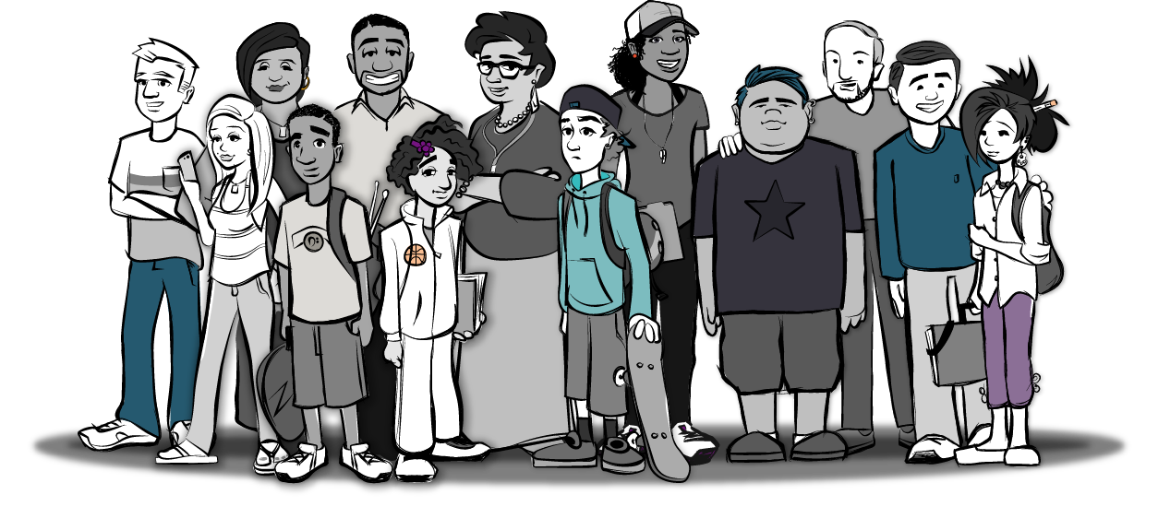
Healthy Relationships Toolkit for Parents
6th Grade

Slide 2
Session 1:
Parents Make a Difference

Slide 3
Goals of Healthy Relationships Toolkit for Parents
Learn how to become better health teachers for our children
  You are your child’s most important teacher.
  You must have a message too.
  If you want to know the end, look at the beginning.
Learn how to help our children cope with messages about relationships and sex that may not be good for them

Slide 4
Goals of Healthy Relationships Toolkit for Parents
Build our knowledge and skills so we can communicate our expectations about relationships and sex to our children
Provide you with information you can share with others in your family
  He who learns, teaches.
Have fun and enjoy our time together!

Slide 5
Overview of Sessions
Session 1: Parents Make a Difference
  Pyramid of Success: what children need to achieve life goals
  Pressures children face
  The important role of parents
Session 2: Parenting Positively
  Strengthening the parent-child relationship
  Improving parent-child communication
  Supervising our children

Slide 6
Overview of Sessions
Session 3: Parents are Educators
  The realities of adolescent relationships and sexual behaviors
  Why parents should be relationship and sex educators
  Sex education
  What parents can do
Session 4: I Think I Can, I Know I Can
  Difficulties of discussing issues
  Tools for talking to your child about relationships and sex
  Figuring out what to say

Slide 7
Overview of Sessions
Session 5: Parents are Role Models
  Healthy and unhealthy relationships
  Realities of unhealthy relationships
  Parents as relationship and sex educators
  What parents can do
Session 6: Moving Forward
  Child participates in discussion with parent(s)
  4-step parenting plan for peer pressure
  Graduation

Slide 8
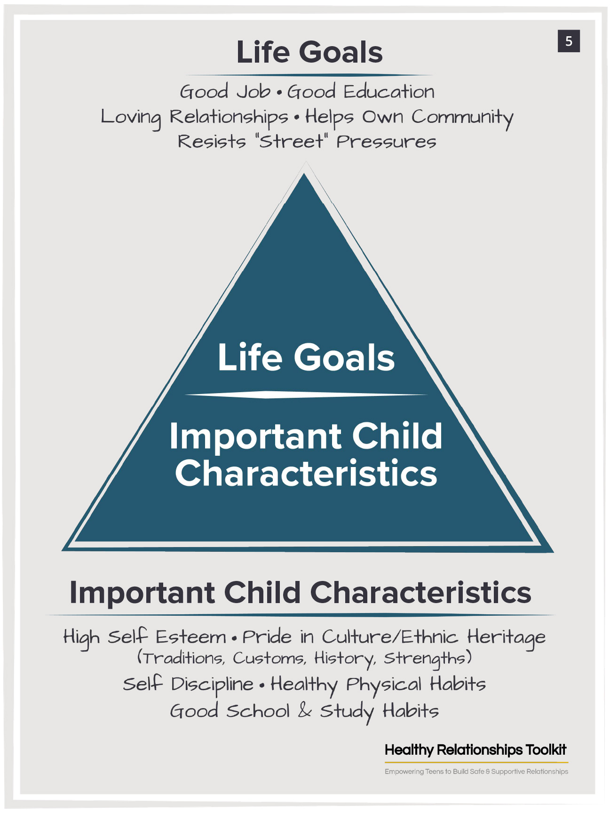
Pyramid of Success
Life Goals
A good job
Good education
Loving relationships
Helps own community
Resists peer pressures

Slide 9
Pyramid of Success
Important Child Characteristics
High self-esteem
Pride in cultural/ethnic heritage (traditions, customs, history, strengths)
Self-discipline
Healthy physical habits
Good school and study habits

Slide 10
Understanding Pre-Teens and Teenagers
Emotional Changes
The pre-teen and teenage years are a period of change
  New and emerging attitudes and skills
  Emotionally adjusting to an in-between place of childhood and adulthood
  Independent one day, childlike the next

Slide 11
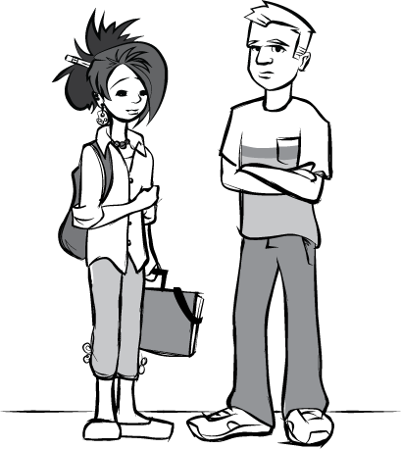
Understanding Pre-Teens and Teenagers
Relational Changes
Changes occur in their relationships with others
  Begin to rely more on friends
  Explore values and opinions of peers
  Want to spend more time with friends
  May start talking or acting a lot like their friends
  Social interactions change, start to deal with issues like peer pressure, dating, fitting in
Notes:
Changes During Adolescence
Changes in Social Relationships
Begin to rely more on friends
Influenced by friends and peers
Want to spend more time with friends
Interested in individuals in a romantic way

Slide 12
Understanding Pre-Teens and Teenagers
Physical Changes
Adolescent bodies are changing a lot
Most 9- to 12- year olds have started to have some normal sexual changes such as:
  Periods
  Breast and genital development
  Erections and sexual arousal
  Experimentation with masturbation

Slide 13
Understanding Pre-Teens and Teenagers
Sexual Changes
As their bodies change to look more like adults:
  Will begin engaging in some of the more adult-like behaviors
  Will start having sexual feelings
May display these feelings through the way they dress and act
May start experimenting with sexual activities
This is tough for them and sometimes for parents too

Slide 14
Understanding Pre-Teens and Teenagers
Parents Make a Difference
Pre-teens and teenagers feel like their experiences are unique
No one can really understand where they are coming from
  Show them that you can try to understand
  Try putting yourself in your child’s shoes

Slide 15
Understanding Pre-Teens and Teenagers
Parents Make a Difference
Parents are needed to help pre-teens understand and negotiate changes
  Parents’ opinions matter
  Staying close to your child is important
  Spending time with your child is important
Parents make a difference!

Slide 16
Why Focus on Children 9- to 12- Years Old?
Seize the moment
  What you do now will lay the foundation for what happens in later years
Snooze and Lose
  Waiting to discuss issues such as healthy relationships and sexuality in later years risks missing a chance to have the greatest impact

Slide 17
Why Focus on Children 9- to 12- Years Old?
Children are entering a stage (puberty) when many things are happening
  Physically
  Emotionally
  Socially
  The way they think
  What they are exposed to
Puberty starts at earlier ages than in the past

Slide 18
Why Focus on Children 9- to 12- Years Old?
Children of all ages are bombarded with information on relationships and sex everyday
  Children need parents to filter this information
  Children need to learn about relationships and sexual issues from your words and actions
  If parents are silent, outside influences will be in control

Slide 19
Why Focus on Children 9- to 12- Years Old?
Children can be very cruel to each other
  This can open the door for parents to improve their relationship with their children by offering the unconditional love that peers often do not provide

Slide 20
Why Focus on Children 9- to 12- Years Old?
Foundation Forming. Now is the time to help your children develop:
  Values
  Attitudes
  Maturity
  Skills
Build your skills. HeaRT for Parents will help you build skills to:
  Begin talking with your child now
  Prepare for upcoming years

Slide 21
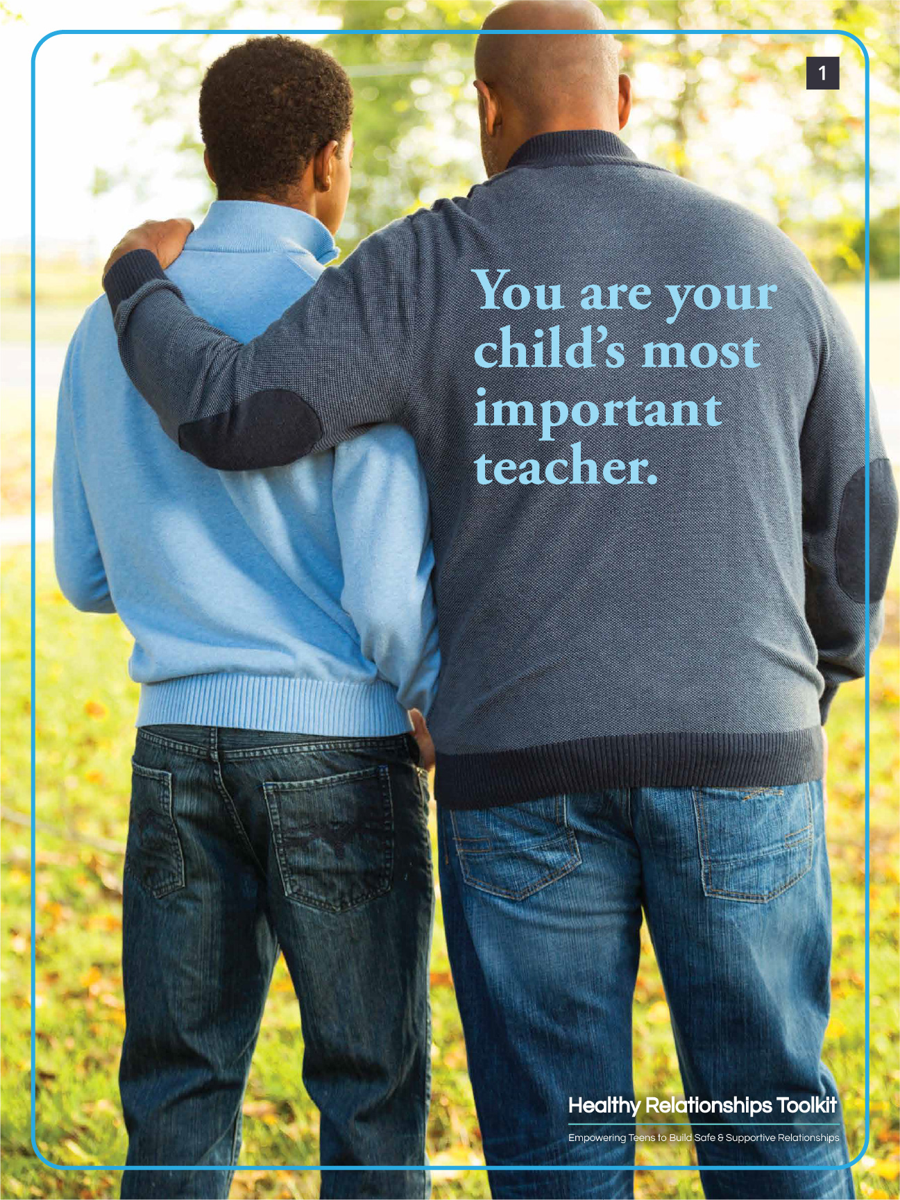
Poster 1

Slide 22

Poster 2

Slide 23

Poster 3

Slide 24
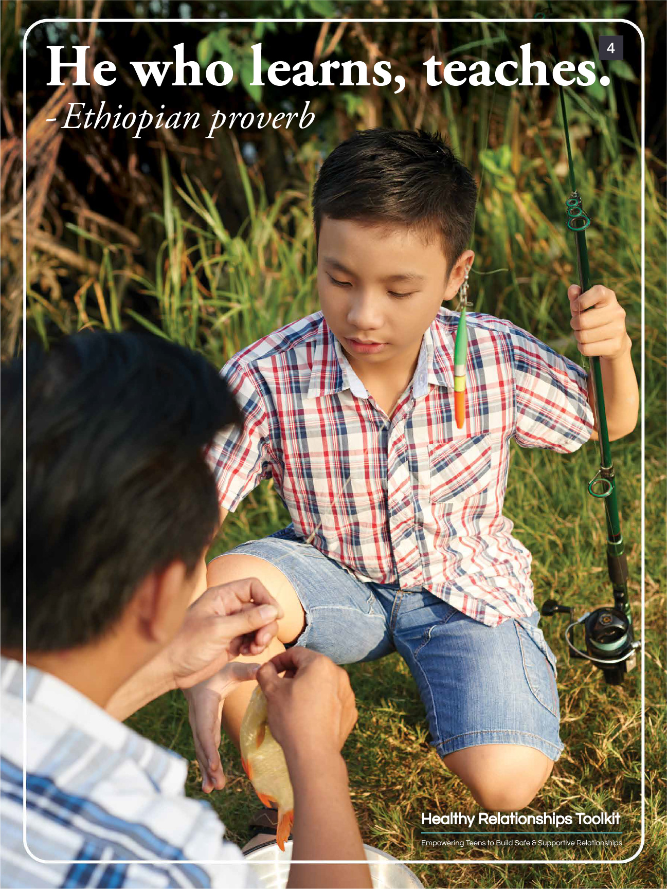
Poster 4

Slide 25
Ground Rules
Suggested Ground Rules:
  Respect each other’s privacy.
  We have the right to our point of view.
  Everyone deserves to be heard.
  We will strive to be supportive and encouraging of others.
  There is no such thing as a stupid question or one “right” answer.
  Attendance is important and expected at all sessions.
  No cell phones and try to limit interruptions.
  Mute yourself when not talking.
Notes:
Suggested Ground Rules
Respect each other’s privacy.
We have the right to our point of view.
Be respectful of everyone's sexual orientation and gender identity.
Everyone deserves to be heard.
We will strive to be supportive and encouraging of others.
There is no such thing as a stupid question or one “right” answer
Attendance is important and expected at all sessions.
No cell phones and try to limit interruptions.
Mute yourself when not talking.

Slide 26
Icebreaker 1
Introduce yourself and tell us what your favorite food is! Can you remember everyone who went before you?
We’ll go in this order:
  [List Participant Names]
  [Facilitator Last]
Notes:
Facilitator Guide: Page 15

Slide 27
Gaby and Brendon

Slide 28
Icebreaker 2
Where were you born?
Where do you live?
How many children do you have?
Tell me something about your child (age, sex, favorite things, talents, etc.)
Why did you decide to participate in Dating Matters?
Notes:
Facilitator Guide: Page 15

Slide 29
Parking Lot

Slide 30
Video 1: Kids Discuss Their Goals in Life
Kids Discuss Their Goals in Life - YouTube
Notes:
Facilitator Guide: Page 15

Slide 31
Video 2: Pressures Teens Will Face
Pressures Teens Will Face - YouTube
Notes:
Facilitator Guide: Page 18

Slide 32
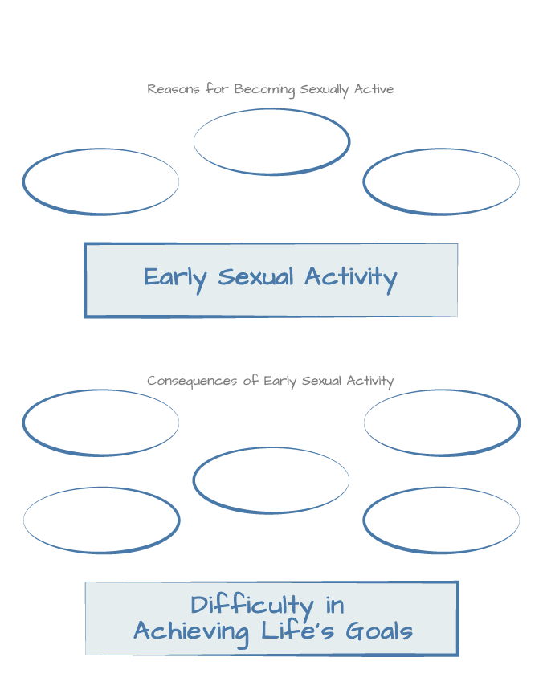
Mapping Risk for Early Sex
Let’s Brainstorm!
  Reasons for Becoming Sexually Active?
  Consequences of Early Sexual Activity?
Notes:
Facilitator Guide: Page 19
Parent Handbook: Page 5
You can add a new slide (or open up a word document) and type out responses to this activity.

Slide 33
Why should parents start addressing adolescent risk behaviors with children as young as 9-12 years old?
[ADD RESPONSES TO THIS SLIDE]
Notes:
Facilitator Guide: Page 21

Slide 34
Session 2:
Parenting Positively

Slide 35
Strengthening the Parent-Child Relationship: Attention
Pay attention to your child’s positive behavior
  Do not take good behavior for granted
  Let your child know you notice when they are behaving well, not just when they do something wrong​
  “Catch them being good”

Slide 36
Strengthening the Parent-Child Relationship: Encouragement
Provide your child with a lot of encouragement
Make encouraging statements
  That’s the way!
  You can do it!
  You’re figuring it out!
  You’re working so hard!

Slide 37
Strengthening the Parent-Child Relationship: Time
Spend one-on-one time with your child
Find something you and your child enjoy doing together
  Cooking
  Sports
  Hobbies
Enjoyable time together helps strengthen relationships

Slide 38
Effective Parent-Child Communication
Really listen to your child
  Make and maintain eye contact
  Giving your attention to something else communicates a lack of interest
Listen with a closed mouth
  Try not to interrupt
Let your child know you have listened
  Restate
  Make appropriate comments

Slide 39
Effective Parent-Child Communication
Do not take over the conversation
  Take turns talking
  Request feedback
Make your verbal and non-verbal messages consistent
  7% of communication is through words
  38% through non-verbal vocal characteristics
  55% through body movements

Slide 40
Effective Parent-Child Communication
Ask open-ended questions to stimulate conversation
  Ask “why” and “what” questions
  Avoid “yes” and “no” questions
Express openness to listening to other views
  Try not to be too judgmental
  Do not criticize their opinions

Slide 41
Effective Parent-Child Communication
Stick to present issue during conflict
  Do not dwell on past problems
Focus on solutions to problems rather than placing blame
Be respectful, avoid put-downs
Use “I” messages describing how you feel
  Say, “I get very worried if I do not know where you are.”
  Instead of saying, “Not letting me know where you are when you are out is very irresponsible.”

Slide 42
Supervising Your Child
As your children get older, they will be doing more things without you
Whenever they leave home, always know at least:
  Where they are going
  What they will be doing
  Who they will be with
  When they will be home

Slide 43
Icebreaker
Tell us your name and share something you enjoy doing with your child (for example: cooking, sports, a hobby).
Notes:
Facilitator Guide: Page 26

Slide 44
Poster 3
Notes:
Facilitator Guide: Page 26

Slide 45
Share Session 1 “Homework”
What values or behaviors of healthy relationships do you model for your child?
What do you want your child to expect in a healthy romantic relationship?
What terms does your child use to describe their relationships with others? What about for romantic or dating relationships?
Notes:
Facilitator Guide: Page 26

Slide 46
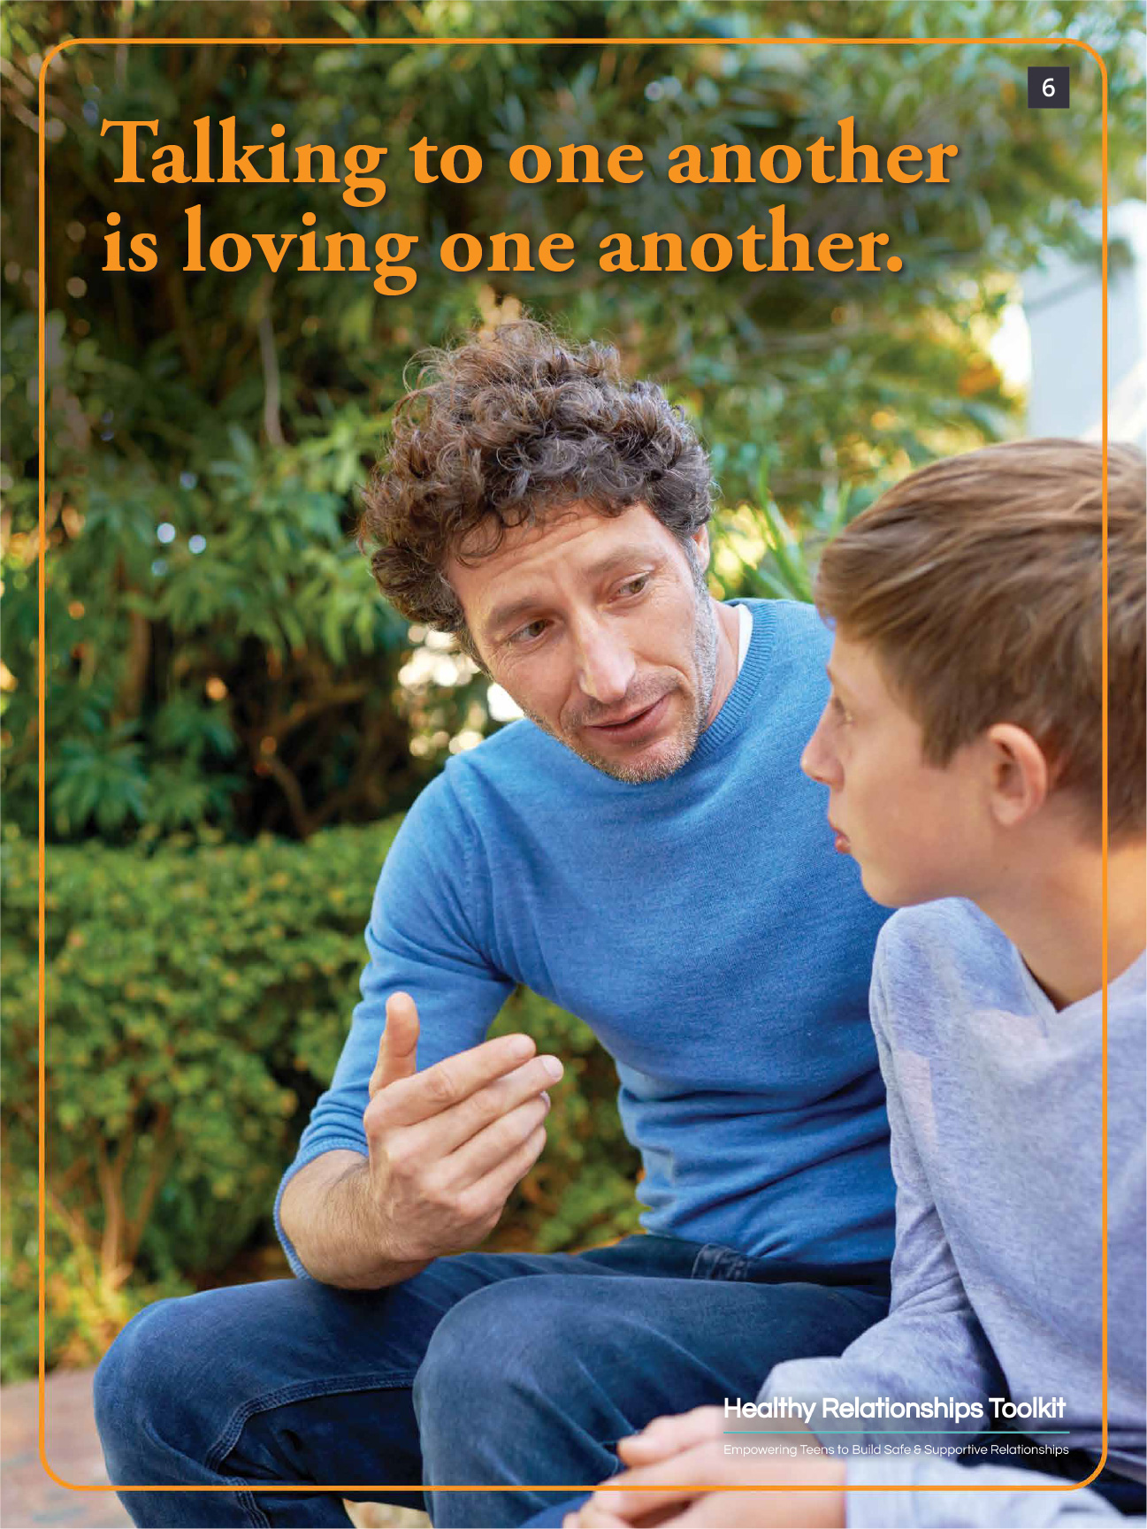
Poster 6
Notes:
Facilitator Guide: Page 26

Slide 47
Video 3: How are your parents important to you?
How Are Your Parents Important to You? - YouTube
Notes:
Facilitator Guide: Page 27

Slide 48
Discussion: Strengthening the Parent-Child Relationship and Communication
Qualities of the “bad” supervisor? How did it feel working for that person?
  [ADD RESPONSES TO THIS SLIDE]
Qualities of the “good” supervisor? How did it feel working for that person?
  [ADD RESPONSES TO THIS SLIDE]
Notes:
Facilitator Guide: Page 28

Slide 49
Discussion: Strengthening the Parent-Child Relationship and Communication
What are some ways that parents can build strong, positive relationships with their children to keep them out of trouble?
[ADD RESPONSES TO THIS SLIDE]
Notes:
Facilitator Guide: Page 29

Slide 50
Poster 5
Notes:
Facilitator Guide: Page 26

Slide 51
Video 4: Parent and Child Interaction
Parent and Child Interactions - YouTube

Slide 52
Video 5: Supervision
Supervision - YouTube

Slide 53
Session 3:
Parents Are Educators

Slide 54
Supervising Your Child
As your children get older, they will be doing more things without you
Whenever they leave home, always know at least:
  Where they are going
  What they will be doing
  Who they will be with
  When they will be home

Slide 55
Parents are the Best Relationship and Sex Educators Because…
Parents can provide:
Ongoing information (not limited to a one-time event like a sex education class)
Information over time that builds on previous information

Slide 56
Parents are the Best Relationship and Sex Educators Because…
Parents can provide information that is time-sensitive (to a child’s specific questions or experiences)
Children and adolescents want information about relationships and sex from their parents

Slide 57
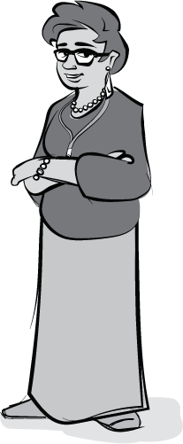
Parents as Relationship and Sex Educators
You should start discussing relationship and sexual issues with your children when they are young
You will need to talk about these issues again and again

Slide 58
Parents as Relationship and Sex Educators
You need to provide information at the right time
  Ask about the questions they have and provide answers
  Provide information based on their needs at that age
As your child gets older, build on the information you have already provided

Slide 59
Things We Know From Research
Talking about relationships and sex does not increase the likelihood that they will occur
  It decreases the likelihood
Parent-child discussions conducted in an open and responsive manner has benefits
  Sexual behavior is reduced among teenagers who are sexually active
  Sexual behavior is reduced among teenagers who are likely to become sexually active

Slide 60
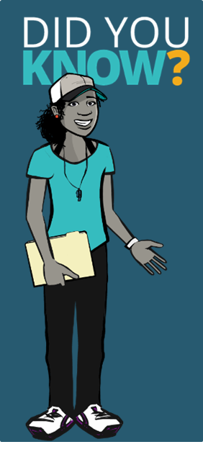
Things We Know From Research
When you do not talk about relationships and sex with your child, there is a consequence
  The child will learn about relationships and sex from other sources
  These sources may have less knowledge resulting in more dangers for your child

Slide 61
What Does it Mean to be Sexually Healthy?
Sexual health is not defined by whether or not an adolescent has been sexually active
Sexually healthy adolescents
  Appreciate their bodies
  Take responsibility for their behaviors
  Communicate with their parents and families about relationships, sex, and sexual issues

Slide 62
What Does it Mean to be Sexually Healthy?
Sexually healthy adolescents
  Communicate effectively, appropriately, and respectfully about relationships and sex with both males and females
  Express love and intimacy in ways that are age appropriate

Slide 63
Helping Your Adolescent Become Sexually Healthy
Model sexually healthy attitudes in your own relationships
  Be clear about your own thoughts and expectations
Be knowledgeable about sexuality
  Be able to provide accurate information
  Know where to get more information if you need it

Slide 64
Helping Your Adolescent Become Sexually Healthy
Discuss puberty with children
Discuss sexuality with children
Be approachable
Try to understand you child’s point of view
  Do not just lecture

Slide 65
Helping Your Adolescent Become Sexually Healthy
Foster responsible decision-making
Help your adolescent develop an understanding of values
Set and maintain limits and other activities outside of school

Slide 66
Helping Your Adolescent Become Sexually Healthy
Stay actively involved in your child’s life
Ask questions about friends and romantic partners
Provide access to health care services

Slide 67

Poster 7

Slide 68

Poster 8

Slide 69

Poster 9

Slide 70
Facts about Dating and Sex in Adolescence
3 in 10 high school students report having sex
Almost half (48%) of sexually active high school students report they did not use a condom the last time they had sex
40% of 8th graders reportedly date

Slide 71
Session 4:
I Think I Can, I Know I Can

Slide 72
Seven Tips for Talking to Your Child About Relationships and Sex
Be prepared
  Know your own expectations
  Decide which topics you will and will not talk about
  Think about what you might say in advance
  Talk to others

Slide 73
Seven Tips for Talking to Your Child About Relationships and Sex
Relax
  You do not need to know all of the answers
Start now
  It is up to you to begin conversations with your child
  Do not wait for your child to initiate

Slide 74
Seven Tips for Talking to Your Child About Relationships and Sex
Listen to your child
  Do not turn questions away
  Find out where their question is coming from
  Listen to their point of view

Slide 75
Seven Tips for Talking to Your Child About Relationships and Sex
Talk about relationships and sex again and again
  Talk early and often
  Use teachable moments
  Use everyday opportunities to clarify any issues regarding relationships and sex
  Talk about all types of things
    Understanding their body and change
    Making healthy decisions
    How to handle peer pressure
    How to know when you are ready to be sexually active

Slide 76
Seven Tips for Talking to Your Child About Relationships and Sex
6. Use the Facts + Expectations Formula
  Start with the facts
    Provide accurate information without any judgments or opinions
  Follow it with a statement of your expectations
    Add your personal perspective, experience, or beliefs regarding their behavior

Slide 77
Seven Tips for Talking to Your Child About Relationships and Sex
7. Accept your child
  It’s important to show your child acceptance and support
  Children will develop their own beliefs that may differ from yours
  These conversations will not necessarily end with your child agreeing with everything you think (or vice versa)— and that is ​okay​
  Remember, there is nothing more important than your relationship with your child. If they still feel safe, secure, and loved at the end of your conversation, it was a success!

Slide 78
Relationship and Sex Education Topics
Understanding your body and how it changes as you grow and develop
How to handle peer and partner pressures to have sex
Information about STDs
Information about birth control
Information about abstinence

Slide 79
Relationship and Sex Education Topics
Information about condom use
Information about menstruation
Discussion of masturbation
How to know when you are ready to be sexually active
Proper hygiene

Slide 80

Poster 10

Slide 81
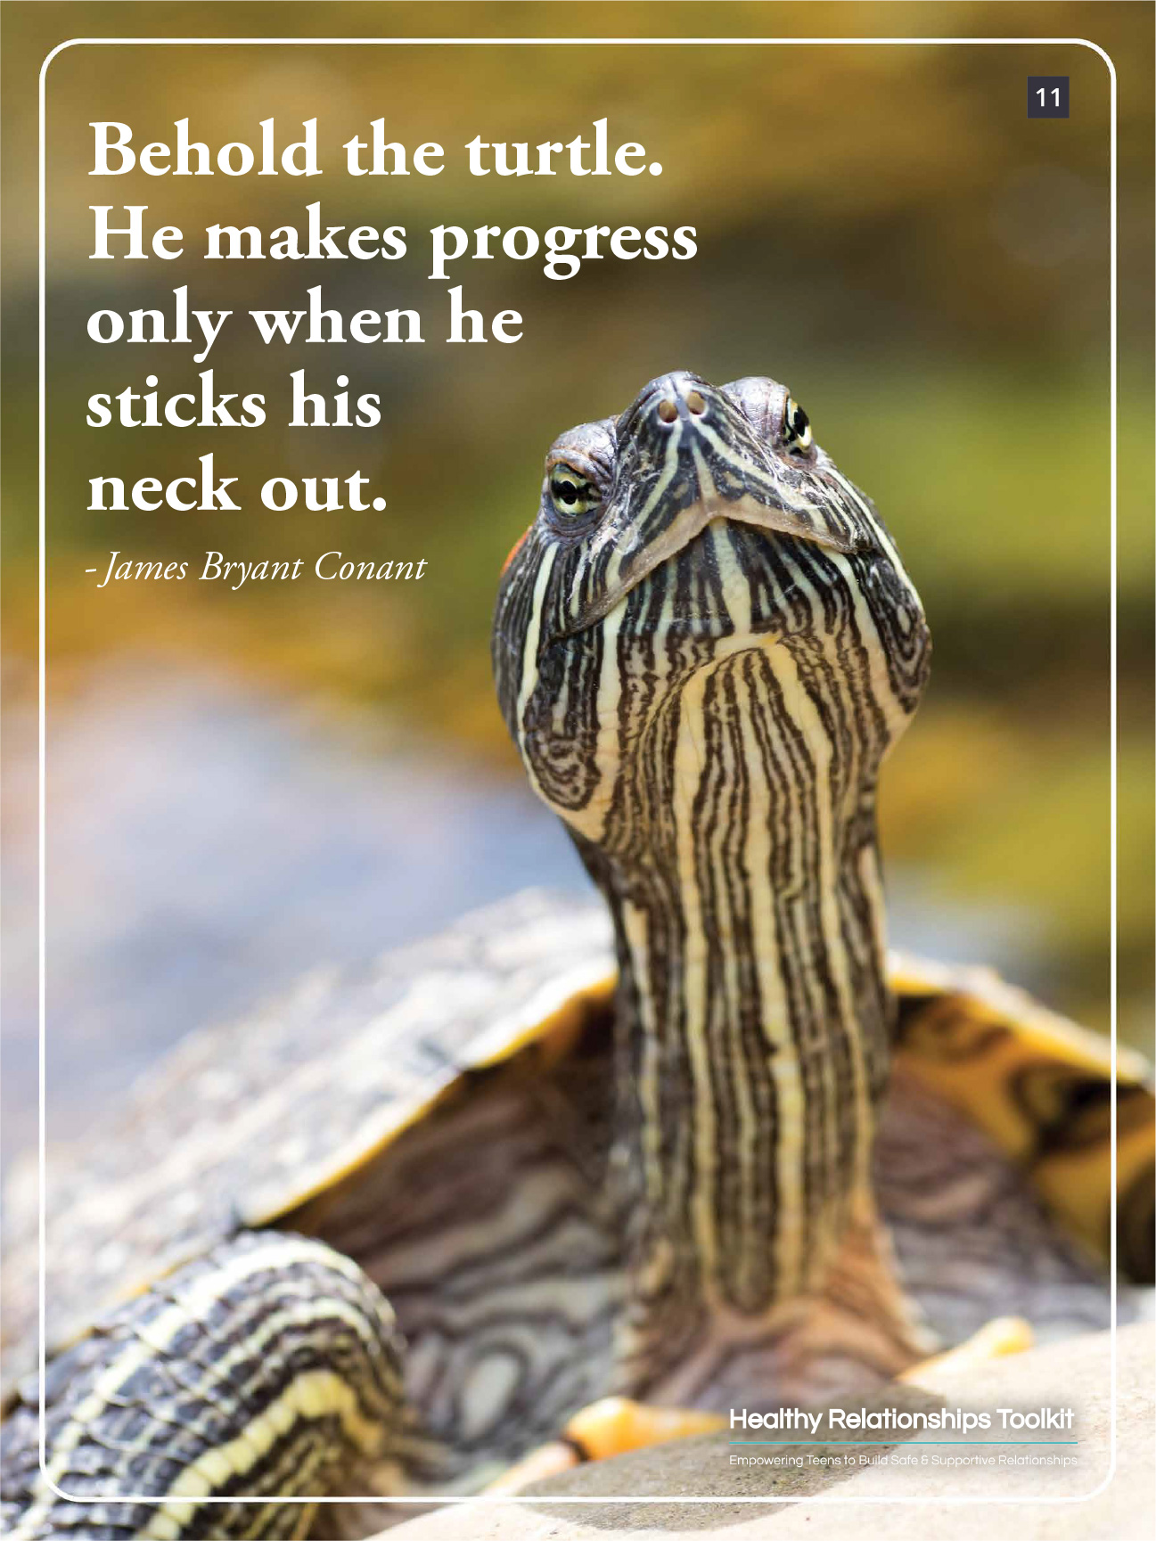
Poster 11

Slide 82
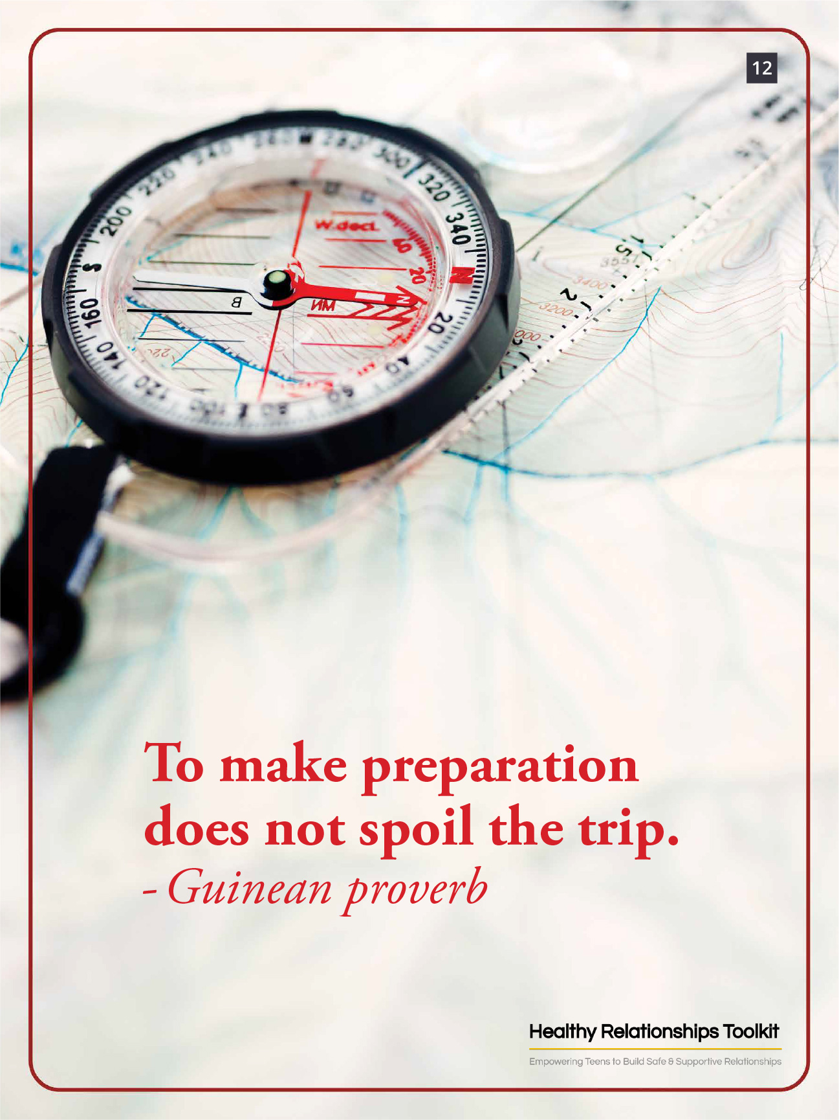
Poster 12

Slide 83
Communicating Our Expectations
What are different expectations ​and values ​parents can have about healthy relationships?
What effect do these values have on the messages parents give to their children?
What are some strategies parents can use to overcome their resistance to discussing relationship- and sex-related issues with their children?

Slide 84




Supplement 4.2: Teachable Moments Question Cards
Child gets in the car
after soccer practice and tells parent a story about kids “hooking up,” then asks parent, “What is hooking up?”
Child finds a condom in mom’s purse and asks,
“What is this?”
Pre-teen girl calls mother from school and says she is bleeding from her vagina and asks, “What is wrong with me?”
Child walks in on parents having sex and asks,
“What are you doing?”

Slide 85
Supplement 4.2: Teachable Moments Question Cards
Two children are talking about a young pregnant girl. One child says to parent, “I thought you had to be married to have a baby.”
Child finds a tampon in the bathroom and asks parent, “What is this?”
A mother had other sex partners before getting married. Her child asks: “Have you ever had sex with someone other than dad?”
A mother had sex for the first time in middle school. Her child asks: “How old were you when you had sex for the first time?”

Slide 86
Supplement 4.2: Teachable Moments Question Cards
A mother and father had sex after dating only a couple of weeks. Their 15-year-old child asks: “How long did you and mom wait to have sex?”
A divorced mother has been sexually active with dating partners since separating from her child’s father. Her child asks: “Do you have sex with the men you date?”
After being at a friend’s house, your son returns home and asks why his friend has two moms.
A boy asks his father:
“Is it okay to have sex with
a girl you don’t really like
just because you want to
have sex?”

Slide 87
Supplement 4.2: Teachable Moments Question Cards
Your daughter who has a serious boyfriend asks, “Why do guys get angry when you talk to someone else, even other girls?”
A son asks his father:
“Do you ever see pornography on the internet? Is that what sex is really like?”
After being at a friend’s house, your daughter returns home and asks,
“Has dad ever hit you?”

Slide 88
Session 5:
Parents Are Role Models

Slide 89
Review: Seven Tips for Talking to Your Child About Relationships and Sex
Be prepared
  Know your own expectations
  Decide which topics you will and will not talk about
  Think about what you might say in advance
  Talk to others

Slide 90
Review: Seven Tips for Talking to Your Child About Relationships and Sex
Relax
  You do not need to know all of the answers
Start now
  It is up to you to begin conversations with your child
  Do not wait for your child to initiate

Slide 91
Review: Seven Tips for Talking to Your Child About Relationships and Sex
Listen to your child
  Do not turn questions away
  Find out where their question is coming from
  Listen to their point of view

Slide 92
Review: Seven Tips for Talking to Your Child About Relationships and Sex
Talk about relationships and sex again and again
  Talk early and often
  Use teachable moments
  Use everyday opportunities to clarify any issues regarding relationships and sex
  Talk about all types of things
    Understanding their body and change
    Making healthy decisions
    How to handle peer pressure
    How to know when you are ready to be sexually active

Slide 93
Review: Seven Tips for Talking to Your Child About Relationships and Sex
6. Use the Facts + Expectations Formula
  Start with the facts
    Provide accurate information without any judgments or opinions
  Follow it with a statement of your expectations
    Add your personal perspective, experience, or beliefs regarding their behavior

Slide 94
Review: Seven Tips for Talking to Your Child About Relationships and Sex
7. Accept your child
  It’s important to show your child acceptance and support
  Children will develop their own beliefs that may differ from yours
  These conversations will not necessarily end with your child agreeing with everything you think (or vice versa)— and that is ​okay​
  Remember, there is nothing more important than your relationship with your child. If they still feel safe, secure, and loved at the end of your conversation, it was a success!

Slide 95
Healthy Relationship Characteristics
Healthy dating relationships have the following characteristics:
  Both partners feel equal power
  Trust
  Open and honest communication
  Respectful interaction styles
  Space to pursue individual interests
  Appropriate boundaries

Slide 96
Unhealthy Relationship Characteristics
Unhealthy dating relationships have the following characteristics:
  One or both partners feels disempowered
  Absence of trust
  Poor communication
  Partners are disrespectful to one another
  Not enough space is allowed to pursue individual interests
  Boundaries may be overstepped/disregarded

Slide 97
What is Teen Dating Violence?
Specific type of unhealthy relationship
Includes actual or threatened harm
Can be:
  Physical
  Sexual
  Emotional (psychological/verbal)
  Stalking

Slide 98
What is Teen Dating Violence?
Occurs in “dating” relationships
  Current or former partner, boyfriend, girlfriend
Can occur in all couples
Can occur in person or electronically

Slide 99
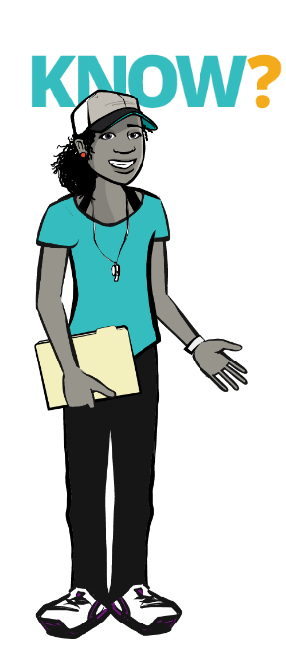
Why Should I Worry?
The Realities of Teen Dating Violence
40% of 8th graders reportedly date
All youth are at risk of being a victim of and perpetrating dating violence
1 in 12 (or 8%) of high school students report being hit, slapped, or physically hurt on purpose by a boyfriend or girlfriend

Slide 100
Why Should I Worry?
The Realities of Teen Dating Violence
Consequences of teen dating violence are serious:
  Tend to be depressed and do poorly in school
  Engage in unhealthy behaviors (for example: using drugs and alcohol)
  Think about or attempt suicide
  Greater risk for being victimized in the future

Slide 101
Why Should I Worry?
The Realities of Teen Dating Violence
Certain parenting behaviors are associated with increased risk for teen dating violence exposure
  Conflict between parents
  Violence in the home (experienced or witnessed)
  Harsh parenting practices
  Low parental monitoring
  Negative parent-child interactions
  Poor parent-child boundaries
  Argumentative, threatening, or critical family communications

Slide 102
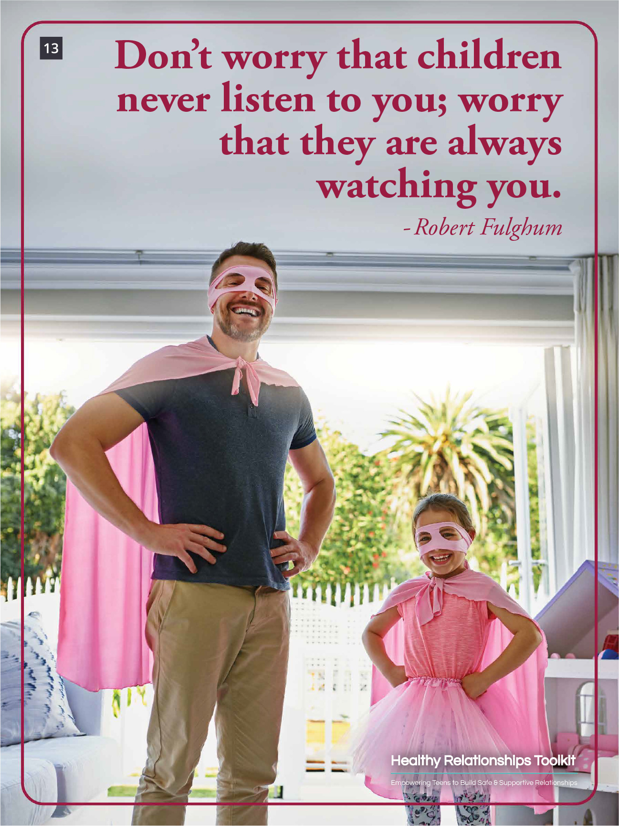
Poster 13

Slide 103

Poster 14

Slide 104
Video 6: Children See. Children Do.
Children See. Children Do. - YouTube

Slide 105






Supplement 5.1: Relationship Behavior Cards
My partner asked me to quit my clubs and hobbies to spend more time with them.
When my family or other friends want to spend time with me, my partner tells me that they are too controlling.
My partner supports me in my personal and academic goals.
My partner gets jealous of my friends, who are girls. She thinks they are flirting with me.
My partner tells me he must always know where I am.
My partner listens to me when I am upset.

Slide 106
Supplement 5.1: Relationship Behavior Cards
Me and my partner….quote repeats. We may need to flag to the client
Me and my partner hangout together but also have our own separate hobbies.
My partner tells me I am ugly, and that I am lucky to have them.
My partner tells me that he will spread rumors about me if I do not have sex with him.
My partner trusts me to hang out with friends of the opposite sex.
My partner hits me when she is angry.

Slide 107
Supplement 5.1: Relationship Behavior Cards
My partner sometimes makes fun of me in front of friends sometimes, but she says it is just teasing.
Me and my partner talk about problems in our relationship but usually only whenever there is an issue.
My partner screams at me when she gets upset, but later apologizes.
When my partner and I got into an argument, he sent some of my private pictures and text messages all over the school.
My partner shows affection, but sometimes it is annoying when he does it in public.
Sometimes me and my partner get bored with one another.

Slide 108
Supplement 5.1: Relationship Behavior Cards
My partner says that if I break up with him, he’ll tell my parents I’m gay.
My partner gets upset if I do not return phone calls right away.
My partner threatens to kill themselves if I leave them.
My partner posts embarrassing pictures or information about me on social media.
My partner texts me a hundred times per day to check in on me.
My partner says we need to hang out every day.

Slide 109
Supplement 5.2: Teen Dating Violence Behavior Cards
True or False?
Teens who identify as lesbian, gay, or bisexual are less likely to experience dating violence than those who identify as straight.
True or False?
Dating violence does not start until the teenage years.
False
Among adults that experience rape, physical violence, and/or stalking by an intimate partner, 23% of women and 14% of men first experienced some form of partner violence between 11 and 17 years of age.
False
Anyone can experience abuse and violence in their relationships and lesbian, gay, and bisexual people are no different.

Slide 110


Supplement 5.2: Teen Dating Violence Behavior Cards
True or False?
Witnessing violence in the home has no effect on whether children will be involved in dating violence either as the person who experiences violence or as the person who perpetrates violence.
True or False?
Boys are as likely as girls to experience dating violence.
False
About equal numbers of boys and girls experience physical dating violence. However, girls experience higher rates of dating violence overall including physical and sexual dating violence.
False
Teens who see violence between
their parents/guardians are more
likely to be involved in dating
violence, either as the person who experiences violence or as the person who perpetrates violence.

Slide 111

Supplement 5.3: Relationship Role-Play Cards
Parent: Your child has brought their new boyfriend/girlfriend home for dinner for the first time. After they leave, you want to have a conversation about their
relationship.
Parent: Another parent or caregiver has come up to you in a grocery store and told you that her son is dating your child. This is the first you are hearing of the relationship.
Parent: You find a text message on your child’s phone and the person is asking for your son/daughter to say something sexy and send a naked picture.
Child: There is a cute guy/girl at school that you like but some of the things they have been saying to you in text messages make you uncomfortable. Now your parent found the messages.
Child: You have been hiding the fact that you have been dating an older guy from your parents. You wanted to tell them eventually, but they found out before you could let them know.
Child: You bring your partner over for the first time. You’re both really nervous, but you also both agree it is necessary.

Slide 112
Session 6:
Moving Forward

Slide 113
Why Should I Worry?
The Realities of Teen Dating Violence
Certain parenting behaviors are associated with increased risk for TDV
  Parental marital conflict
  Violence in the home (experienced or witnessed)
  Harsh parenting practices
  Low parental monitoring
  Negative parent-child interactions
  Poor parent-child boundaries
  Argumentative, threatening, or critical family communications

Slide 114
Effective Parent-Child Communication
Really listen to your child
  Make and maintain eye contact
  Giving your attention to something else communicates a lack of interest
Listen with a closed mouth
  Try not to interrupt
Let your child know you have listened
  Restate
  Make appropriate comments

Slide 115
Effective Parent-Child Communication
Do not monopolize the conversation
  Request feedback
  Take turns talking
Make your verbal and non-verbal messages consistent
  7% of communication is through words
  38% through non-verbal vocal characteristics
  55% through body movements

Slide 116
Effective Parent-Child Communication
Ask open-ended questions to stimulate conversation
  “Why” and “what” questions
  Avoid “yes” “no” questions
Express openness to listen to other views
  Try not to be too judgmental
  Do not criticize their opinions

Slide 117
Effective Parent-Child Communication
Stick to present issue during conflict
  Do not dwell on past problems
Focus on solutions to problems rather than placing blame
Be respectful, avoid put-downs
Use “I” messages describing how you feel rather than make accusations

Slide 118
4-Step Parenting Plan for Peer Pressure
Help your child plan ahead
  Identify peer pressure situations they are most likely to confront
Help your child recognize signs of potential problems

Slide 119
4-Step Parenting Plan for Peer Pressure
Help your child think ahead about what can they say and do when confronted with specific situations involving peer pressure
Role-play such situations with your child

Slide 120
Pyramid of Success
Certain child characteristics are important for our children to realize their life goals
Health-related choices (such as involvement in unhealthy relationships and sexual activity during adolescence) can keep them from reaching their goals

Slide 121
Parents as Relationship and Sex Educators
Start to talk with them about relationships, sex, and sexual issues when they are young, before they start dating or become sexually active
Provide the right information at the right time
  Answers to their questions
  Information based on their needs at that age

Slide 122
Parents as Relationship and Sex Educators
Have conversations with them again and again and again building on previous conversations as they get older

Slide 123
Tips to Make Talking to Your Child Easier
Be prepared
Relax
Start now
Listen to your child
Talk about relationships and sex again and again and again
Use the Facts + Expectations Formula
Accept your child

Slide 124
Responding to Peer Pressure
Help your child plan ahead
Help your child recognize signs of potential problems
Help your child think ahead
Role-play such situations with your child

Slide 125
Strengthening the Parent-Child Relationship
Pay attention to your child’s positive behavior
Provide your child with a lot of encouragement
Find interest that you share and spend one-on-one enjoyable time with your child

Slide 126
Strengthening the Parent-Child Relationship
Effective Communication
Practice effective communication with your child
  Really listen without interrupting
  Encourage conversation and do not take over
  Be open to other views and respectful
  Make sure your words, body, and tone are all saying the same thing
  Stay in the present focusing on solutions
  Use “I” messages to own your own feelings

Slide 127
Strengthening the Parent-Child Relationship
Parental Supervision
Supervise to help prevent problems
Where?
Who?
What?
When?

Slide 128
Helping Your Adolescent Become Sexually Healthy
Model sexually healthy attitudes in your own relationships
Be able to provide accurate information and know where to get more information
Be understanding of their views and approachable
Discuss puberty and sexuality

Slide 129
Helping Your Adolescent Become Sexually Healthy
Communicate your expectations and help your children understand them
Stay involved, foster decision-making, set limits, and ask questions about friends and romantic partners
Assist your adolescent in accessing health care services when needed

Slide 130

Poster 15

Slide 131

Poster 16

Slide 132

Poster 17

Slide 133
Video 2: Pressures Teens Will Face
Pressures Teens Will Face - YouTube

