Slide 1
6th Grade

Slide 2

Session 1: Healthy Relationships
Notes:
Facilitator Guide: Page 11

Slide 3
Question of the Day
If you could travel to anywhere in the world, where would you go? Why?
Type your answer into the chat box.
Notes:
Facilitator Guide: Page 12

Slide 4
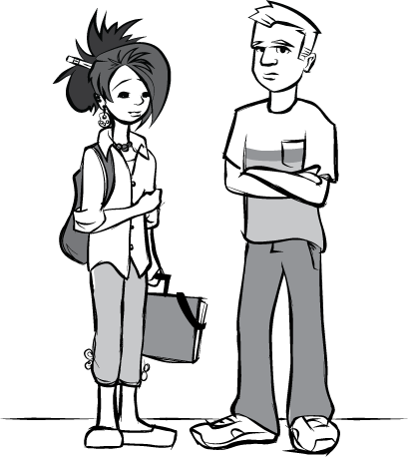
Group Agreements
Respect the privacy of others
The “no name rule”
[insert group agreement]
[insert group agreement]
[insert group agreement]
[insert group agreement]
[insert group agreement]
[insert group agreement]
Notes:
Facilitator Guide: Page 13
Handbook: Page 1
Copy and paste this slide over to the start of every session to remind students of their group agreements.

Slide 5

Parking Lot
[insert topic for later discussion]
[insert topic for later discussion]
[insert topic for later discussion]
[insert topic for later discussion]
[insert topic for later discussion]
[insert topic for later discussion]
[insert topic for later discussion]
[insert topic for later discussion]
Notes:
Facilitator Guide: Page 7
Handbook: Page 26
You can copy this slide over to the next session as you go along- for example, when you finish Session 1, copy over the parking lot slide to Session 2 so you’ll be ready to fill in more topics to come back to.

Slide 6
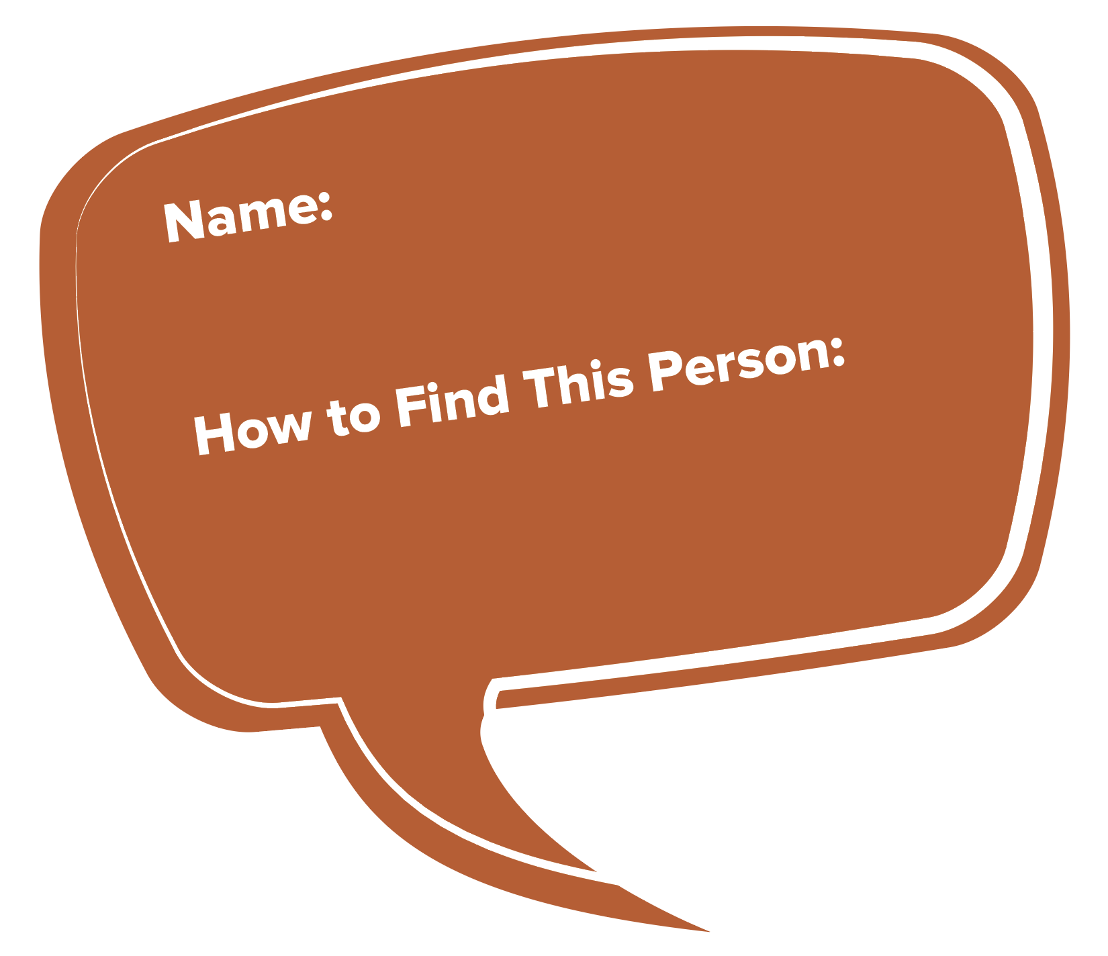
Go-To Trusted Adults
Trusted adults are people who:
  You feel comfortable talking to
  Are concerned about your safety
  You can go to if you were experiencing trouble with a friend, dating partner, or anyone else
Notes:
Facilitator Guide: Page 14
Handbook: Page 2

Slide 7
Healthy Friendships
Do good friends always agree?
Do good friends always keep secrets?
How might a friendship change if it was missing trust?
Is honesty important in other types of relationships, like dating relationships?
Notes:
Facilitator Guide: Page 15

Slide 8
Ingredients of a Healthy Friendship
What are some ways good friends treat each other?
[ingredient/characteristic]
[ingredient/characteristic]
[ingredient/characteristic]
[ingredient/characteristic]
[ingredient/characteristic]
[ingredient/characteristic]
[ingredient/characteristic]
[ingredient/characteristic]
Notes:
Facilitator Guide: Page 15
Add students’ responses to “Ingredients of a healthy friendship”.

Slide 9

Healthy Dating Recipe
Add ingredients for a healthy relationship that are important to YOU
in the measuring cup.
Notes:
Facilitator Guide: Page 17
Handbook: Page 3

Slide 10
Recap & Preview
Session 1:
Go-to trusted adults
Healthy friendships
Healthy dating relationships
Session 2:
Identifying feelings in ourselves and others
Finding healthy and safe ways to show feelings
Notes:
Facilitator Guide: Page 18

Slide 11

Session 2: Understanding Feelings
Notes:
Facilitator Guide: Page 19

Slide 12
Question of the Day
Competition! Write down as many feelings you can think of. For example: mad, sad.
Type your answer into the chat box.
Notes:
Facilitator Guide: Page 20

Slide 13
Our Many Feelings
[insert feeling]
[insert feeling]
[insert feeling]
[insert feeling]
[insert feeling]
Feelings have different intensities. Rate some of the words a scale from 1 to 5.
  1 = less strong
  5 = very strong
Notes:
Facilitator Guide: Page 20

Slide 14
Physical Clues
Our bodies send us clues about how we are feeling. We can look for clues in two areas:
What is going on inside of our bodies
  Heart beating faster
  Upset stomach
Our body language
  Body posture
  Tone of voice
Notes:
Facilitator Guide: Page 22

Slide 15
Physical Clues
Angry Clues
[insert clue]
[insert clue]
Calm/Relaxed Clues
[insert clue]
[insert clue]
Notes:
Facilitator Guide: Page 23

Slide 16
Identifying Feelings In Others
We can use body language clues to help us identify feelings in others.
Notes:
Facilitator Guide: Page 24

Slide 17
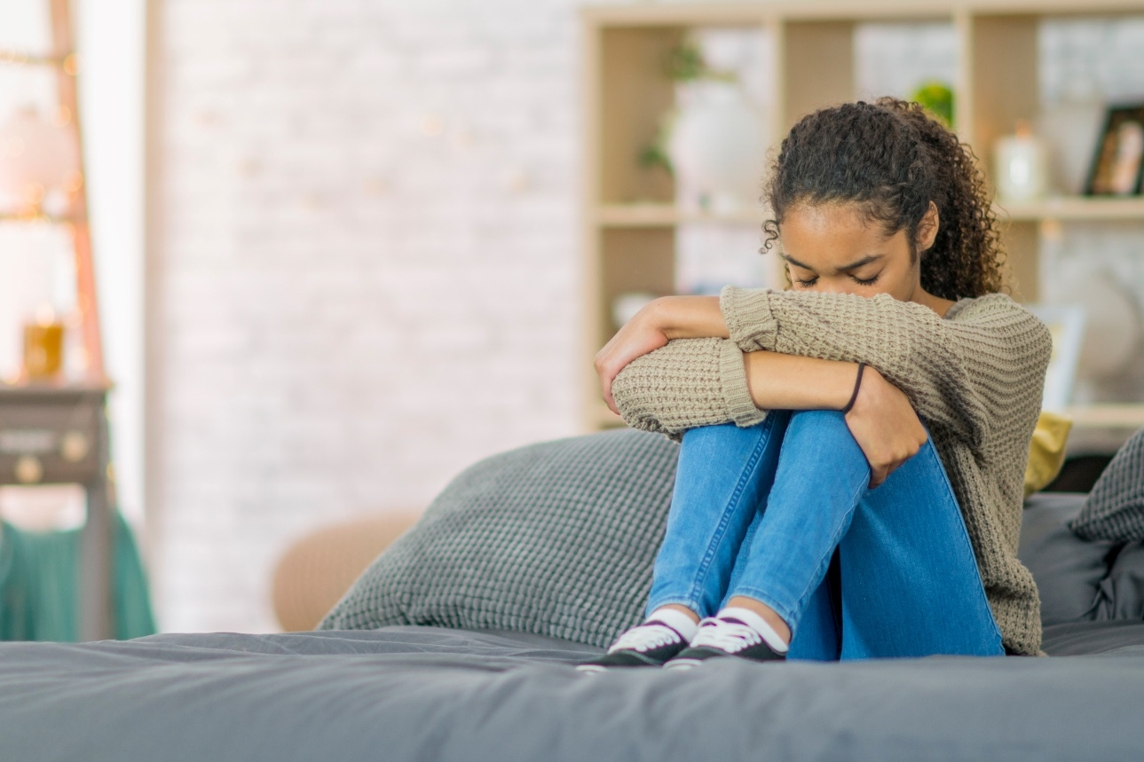
Feelings Charades
Notes:
Facilitator Guide: Page 24
You can use these images and ask students to guess the feelings of person in the image and ask what clues helped them identify the feeling. OR you can ask for volunteers to act out a feeling and private message/chat them the feeling to act out for the group.

Slide 18
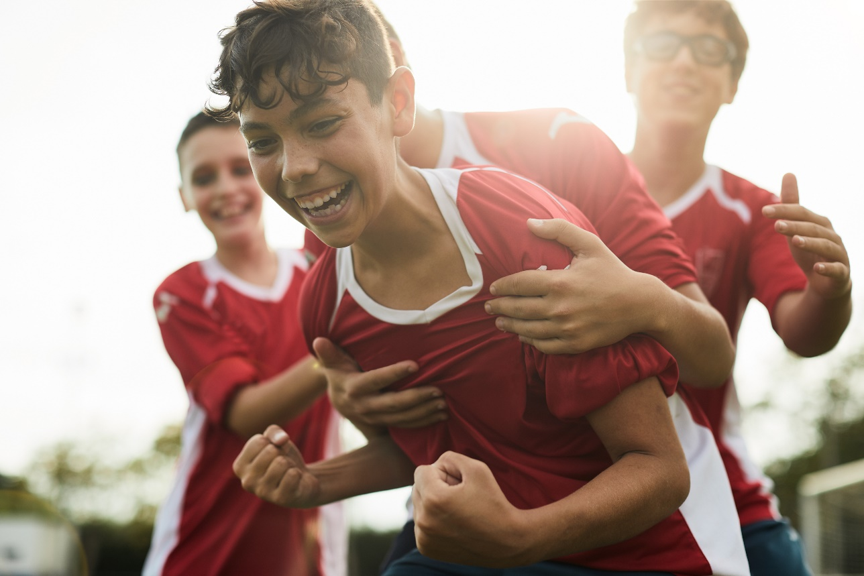
Feelings Charades
Notes:
Facilitator Guide: Page 24
You can use these images and ask students to guess the feelings of person in the image and ask what clues helped them identify the feeling. OR you can ask for volunteers to act out a feeling and private message/chat them the feeling to act out for the group.

Slide 19
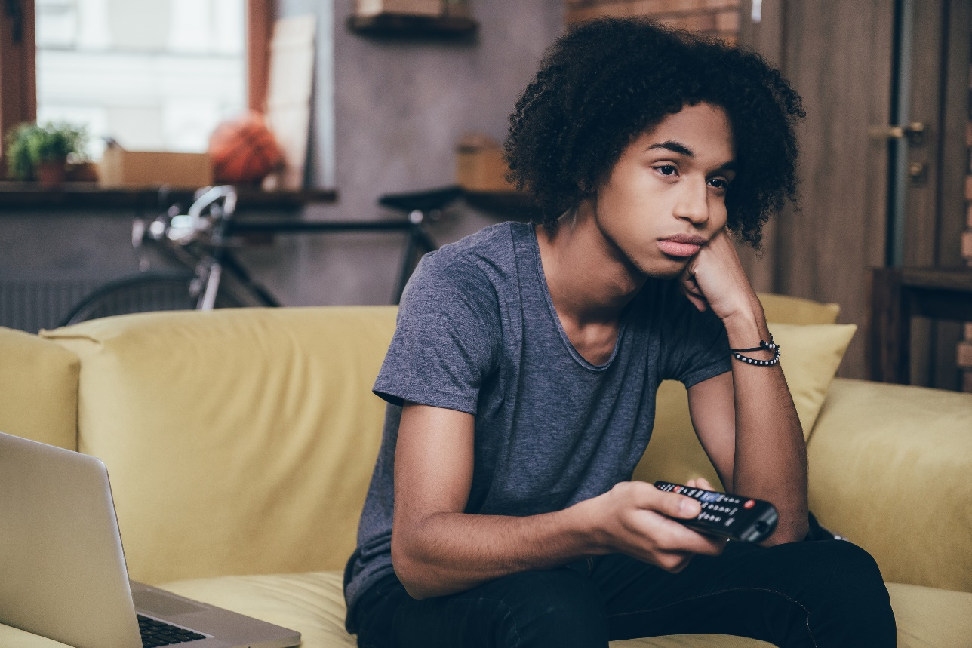
Feelings Charades
Notes:
Facilitator Guide: Page 24
You can use these images and ask students to guess the feelings of person in the image and ask what clues helped them identify the feeling. OR you can ask for volunteers to act out a feeling and private message/chat them the feeling to act out for the group.

Slide 20
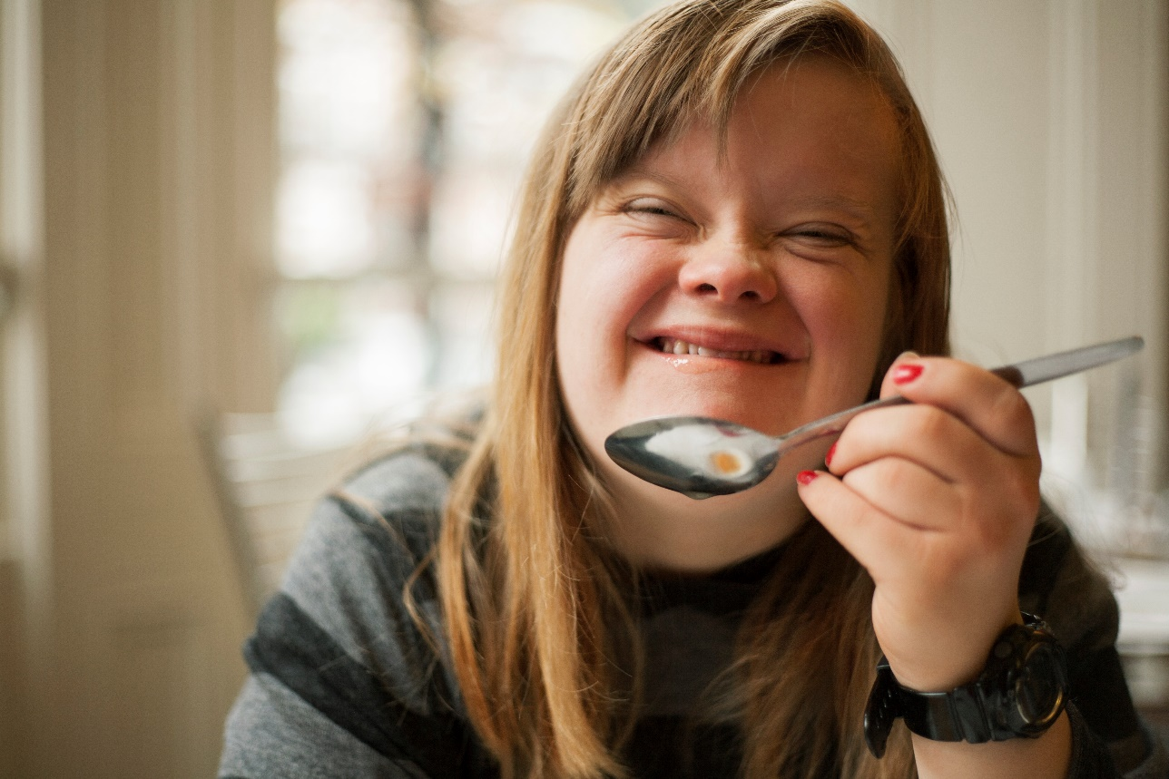
Feelings Charades
Notes:
Facilitator Guide: Page 24
You can use these images and ask students to guess the feelings of person in the image and ask what clues helped them identify the feeling. OR you can ask for volunteers to act out a feeling and private message/chat them the feeling to act out for the group.

Slide 21
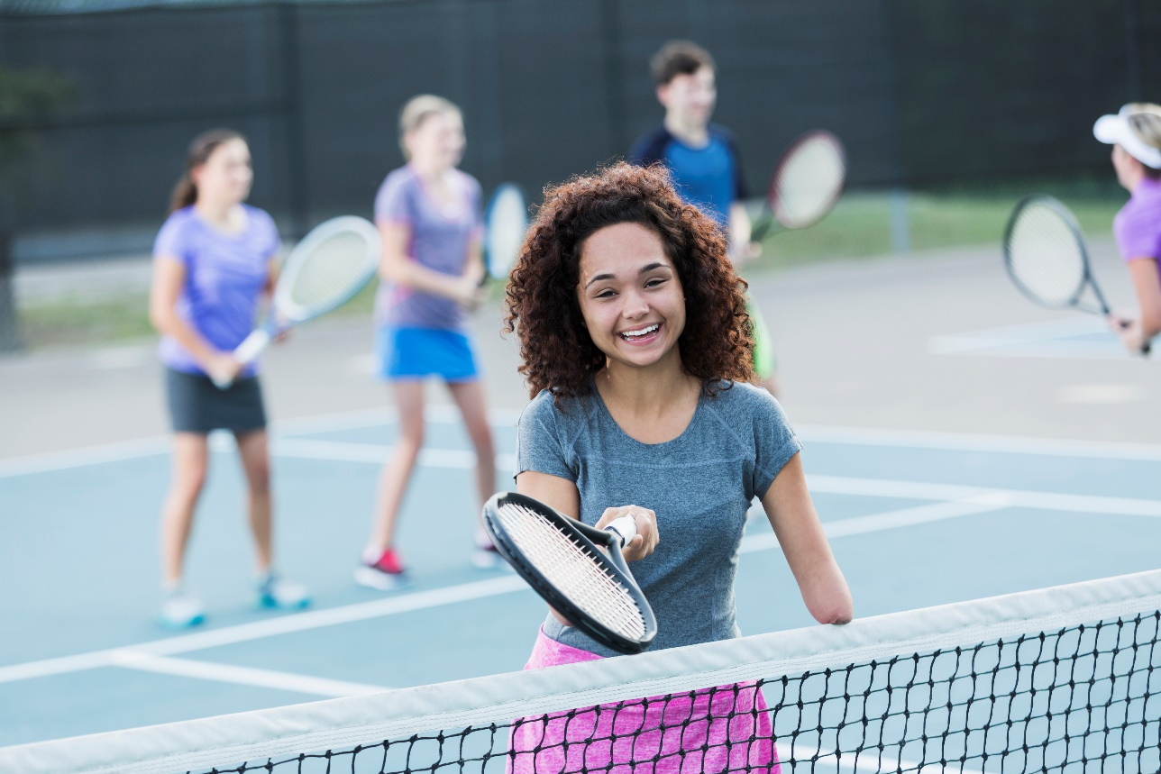
Feelings Charades
Notes:
Facilitator Guide: Page 24
You can use these images and ask students to guess the feelings of person in the image and ask what clues helped them identify the feeling. OR you can ask for volunteers to act out a feeling and private message/chat them the feeling to act out for the group.

Slide 22
How Would You Feel?
Scenario 1: You got a new phone for your birthday. But, your parent says that in order to keep the phone, you have to agree to allow them to read all of your text messages.
Scenario 2: [insert scenario]
Scenario 3: [insert scenario]
Scenario 4: [insert scenario]
Scenario 5: [insert scenario]
Notes:
Facilitator Guide:: Page 26
Handbook: Page 4
Choose from the following situations (it is estimated you will have time for 4–5 situations), or create new ones that are relevant to the students in the class.
Your teacher asks you to read aloud to the class.
Your brother is really happy about getting a new job, but it means he will not be around to hang out in the afternoon.
It is your first day at a new school.
You heard that a house in the neighborhood was broken into.
You just found out that school is cancelled tomorrow.
You were asked out by someone you like. But, later that day you notice that he/she posted some mean comments on Facebook about your friend.
You got a new phone for your birthday. But, your parent says that in order to keep the phone, you have to agree to allow him/her to read all of your text messages.
You are about to ride a roller coaster.
• You called someone you like, but it has been four days and he/she has not returned your call.
• Someone you like asked your friend to go to the movies with him/her.
• You got a B on your math exam.
• You and your friend both try out for pitcher on the baseball team. You are chosen to be the pitcher.

Slide 23
Recap & Preview
Session 2:
Identifying feelings in ourselves and others
Finding healthy and safe ways to show feelings
Session 3:
How to identify, understand, and respond to emotions/feelings in a healthy and safe way
Steps to help us stay in control of feelings
Notes:
Facilitator Guide: Page 27

Slide 24

Session 3: Staying in Control of Feelings & Making Healthy Decisions
Notes:
Facilitator Guide: Page 29

Slide 25
Question of the Day
What is one activity you enjoy doing, and why?
Type your answer into the chat box.
Notes:
Facilitator Guide: Page 30

Slide 26
Physical Clues
Angry Clues
[insert clue]
[insert clue]
Calm/Relaxed Clues
[insert clue]
[insert clue]
Notes:
Facilitator Guide: Page 30
Copy and paste the completed “Physical Clues” slide from Session 2 here.

Slide 27
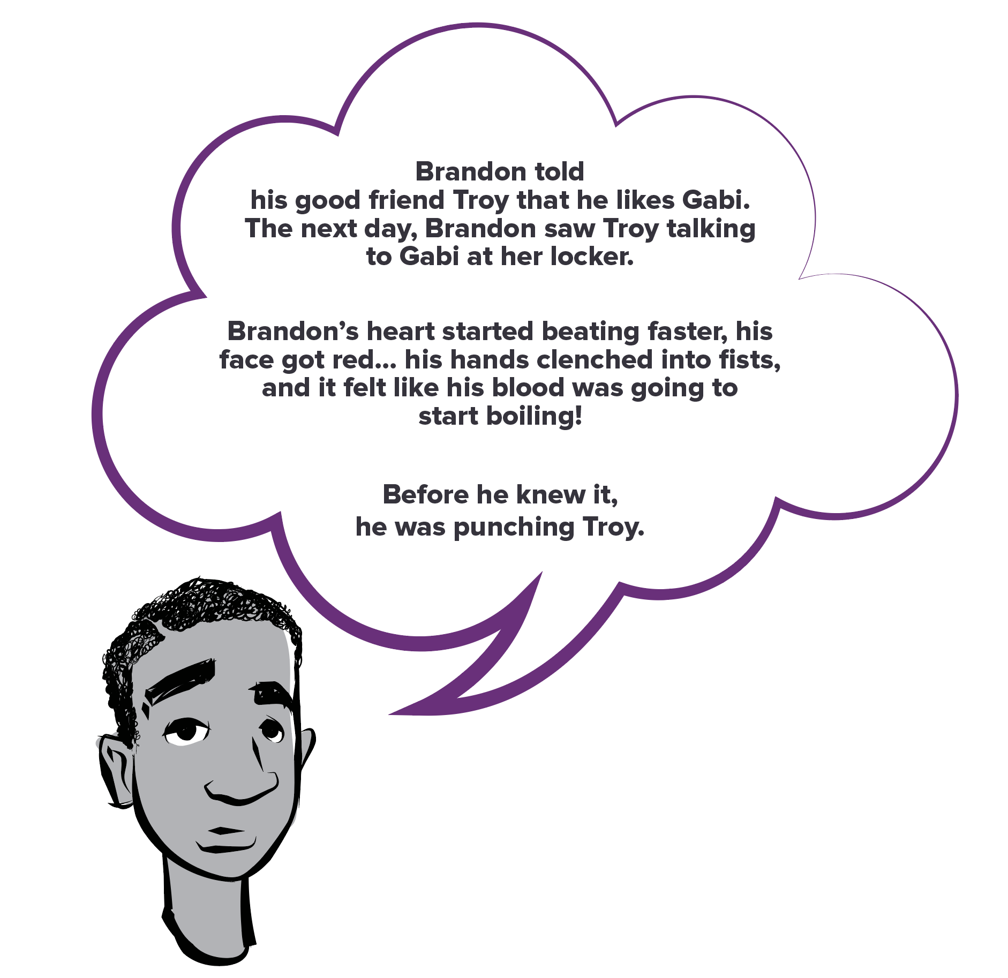
Brandon’s Story
Notes:
Facilitator Guide: Page 31
Handbook: Page 5

Slide 28
Staying in Control of Your Feelings: 4 Steps
Notice what your body is telling you. Then, PAUSE!
Name your feeling
Pick the best way to calm down (and do it!)
Check-in
Notes:
Facilitator Guide: Page 32
Handbook: Page 6

Slide 29
Calming Down
Healthy ways to calm down:
Take deep breaths
Use positive self-talk (things we can say or think that can help us calm down)
Doing something physically active or relaxing
Talk to someone you trust
Notes:
Facilitator Guide: Page 33

Slide 30
Negative Self-Talk, Positive Self-Talk
Jose got an F on his math test.
Malia got a text from her girlfriend. It said, “I am going to hang out with my friends tonight.”
Darius saw Jess walk into science class with her friend. He said “hi” and she did not say anything back.
Isaiah hit Future on the head with a soccer ball in gym class.
Notes:
Facilitator Guide: Page 36
Handbook: Page 7
Options for the Negative Self-Talk, Positive Self-Talk activities: Do it together as a class OR use breakout group function in Zoom (or other virtual platform) and give students 5 minutes with their group or partner to come up with answers to then share with the class.

Slide 31
We Enjoy…
Physically Active
[activity]
[activity]
[activity]
[activity]
[activity]
[activity]
[activity]
[activity]
Relaxing
[activity]
[activity]
[activity]
[activity]
[activity]
[activity]
[activity]
[activity]
Notes:
Facilitator Guide: Page 38
Handbook: Page 7
Go through students’ responses to the question of the day in the chatbox and fill in this slide as students point out which type of activity each response belongs under.

Slide 32
Recap & Preview
Session 3:
How to identify, understand, and respond to emotions/feelings in a healthy and safe way
Steps to help us stay in control of feelings
Session 4:
Healthy communication skills
Verbal and nonverbal communication
Notes:
Facilitator Guide: Page 40

Slide 33

Session 4: Healthy Communication
Notes:
Facilitator Guide: Page 41

Slide 34
Question of the Day
Think about someone who is a good listener. What do they do or say that makes them such a good listener?
Type your answer into the chat box.
Notes:
Facilitator Guide: Page 42

Slide 35
Ingredients of a Healthy Friendship
What are some ways good friends treat each other?
[ingredient/characteristic]
[ingredient/characteristic]
[ingredient/characteristic]
[ingredient/characteristic]
[ingredient/characteristic]
[ingredient/characteristic]
[ingredient/characteristic]
[ingredient/characteristic]
Notes:
Facilitator Guide: Page 42
Copy and paste the completed slide from session 1 for this discussion.

Slide 36


Healthy Communication Skills
Nonverbal communication
  Things we do not say directly
  Messages we send with our body and facial expressions
  Examples: eye contact, gestures, posture, and body movements
Verbal communication
  Things we say and how we say them
  Example: tone of voice
Notes:
Facilitator Guide: Page 42

Slide 37
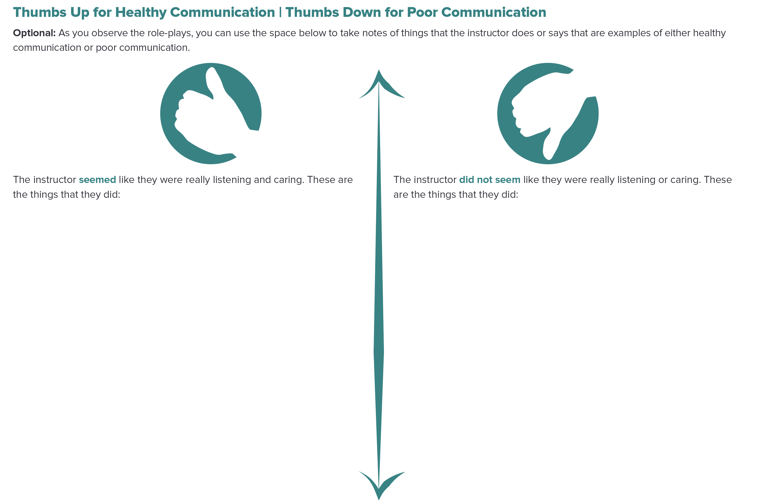
Thumbs Up or Thumbs Down?
Notes:
Facilitator Guide: Page 43
Handbook: Page 9

Slide 38
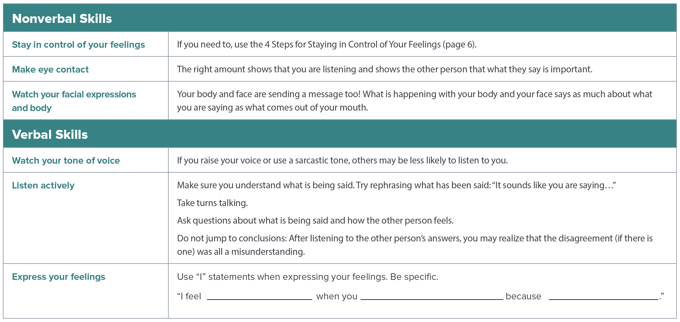
Skills for Healthy Communication
Notes:
Facilitator Guide: Page 45
Handbook: Page 10

Slide 39
Nonverbal Communication Skills
People send messages when they cross their arms, shake their head, point to something, tap their fingers, smile, or roll their eyes.
Notes:
Facilitator Guide: Page 46
Handbook: Page 10
[Add photos of examples]

Slide 40
Verbal Communication Skills
Tone of voice
Active listening
  Rephrase what has been said
  Take turns talking
  Ask questions about what is said and how the other person feels
Notes:
Facilitator Guide: Page 46
Handbook: Page 10

Slide 41
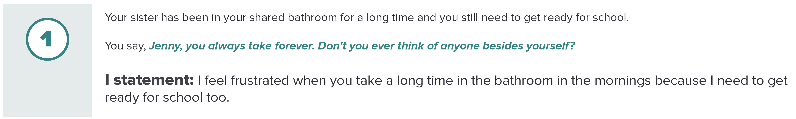
“I” Am Important
“I” statements…
Are a way to clearly express how you feel
Make it easier to express how you feel because you are just talking about yourself
Let’s practice:
Notes:
Facilitator Guide: Page 48
Handbook: Page 11

Slide 42
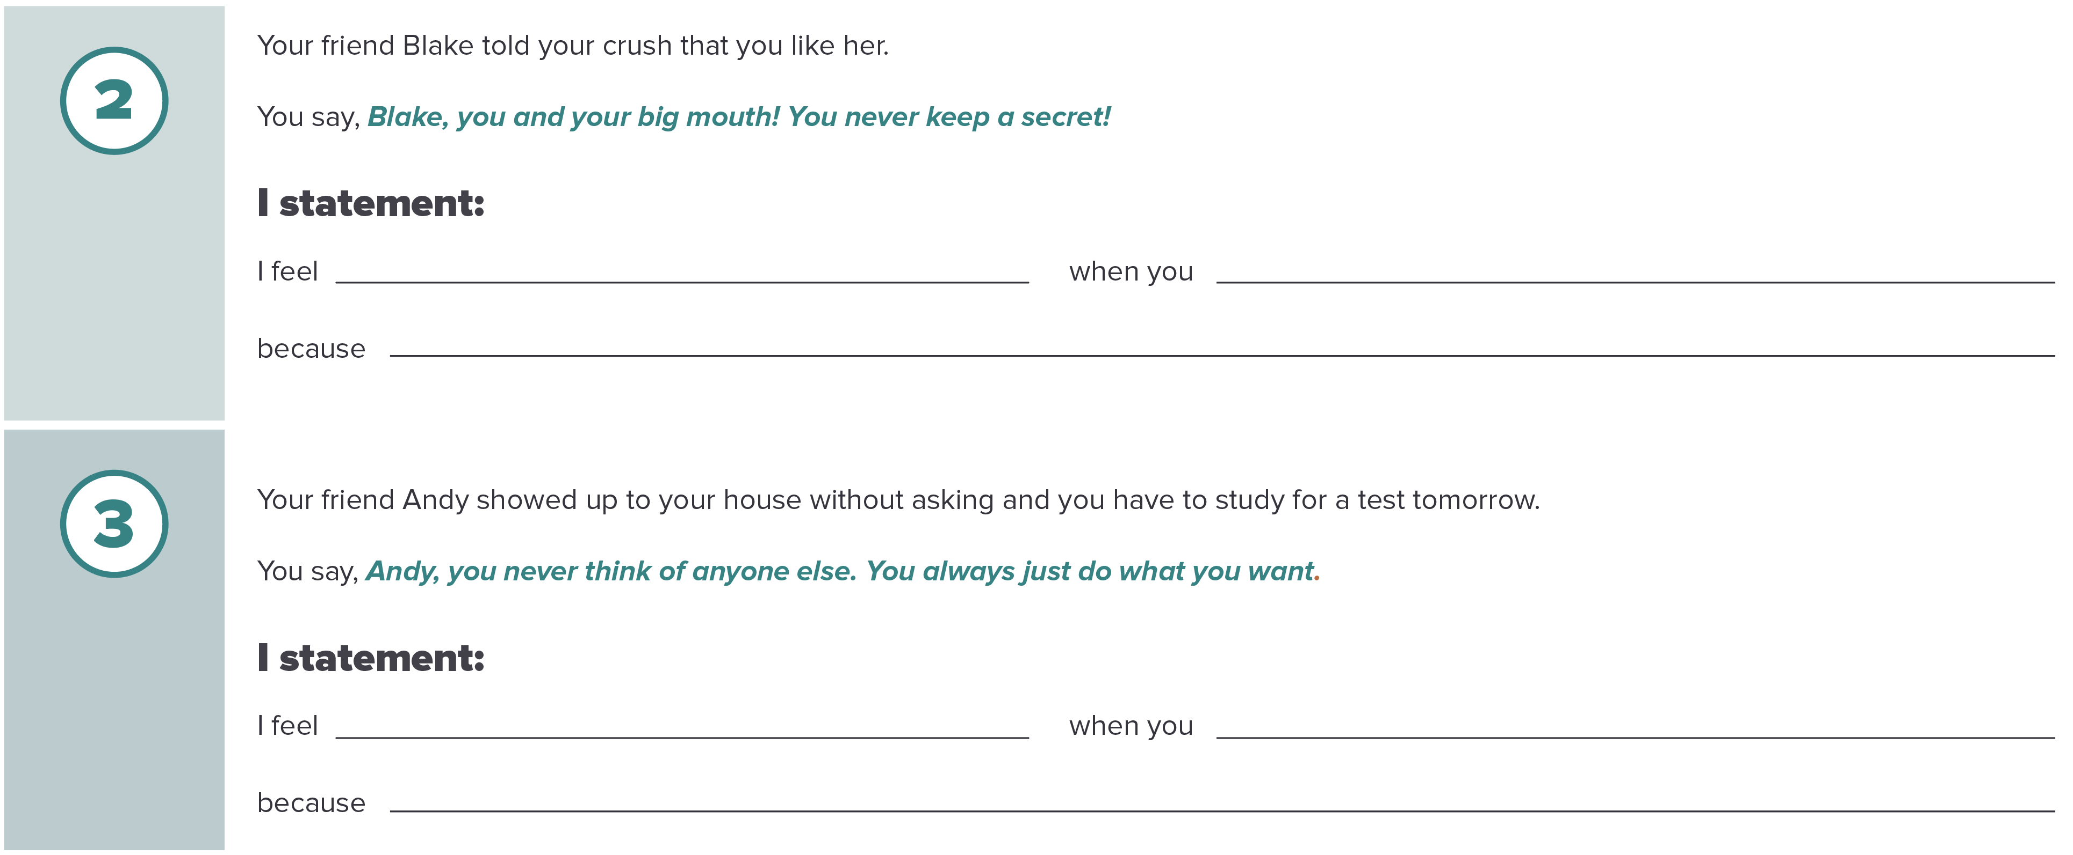
”I” Am Important (continued)
Notes:
Facilitator Guide: Page 48
Handbook: Page 11

Slide 43
Communication Practice
We will practice healthy communication skills with four scenarios
Each scenario:
  Two volunteers will be actors/actresses (girls do not have to play girls and boys do not have to play boys)
  Actors/actresses will try to use each of the healthy communication skills at least once
  The rest of the class will be observers who will check off which healthy communication skills were used during the role-plays on page 12 of your handbooks (pick only one actor/actress to use the checklist for)
Notes:
Facilitator Guide: Page 49
Handbook: Page 12
Pick two volunteers for each of the four scenarios and direct/private message them their scenario. Allow the pairs of volunteers to join a separate breakout session or virtual meeting so they have a few minutes to go over their communication situations. After a few minutes, end their breakout session so they can join the rest of the class.

Slide 44
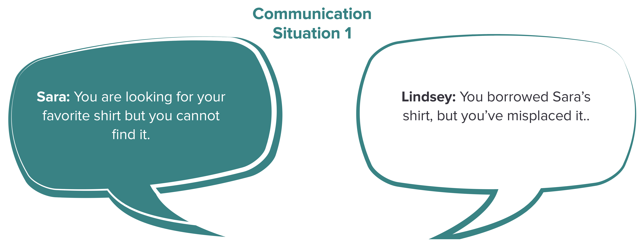
Communication Situation 1
Notes:
Facilitator Guide: Page 51
Handbook: Page 12

Slide 45
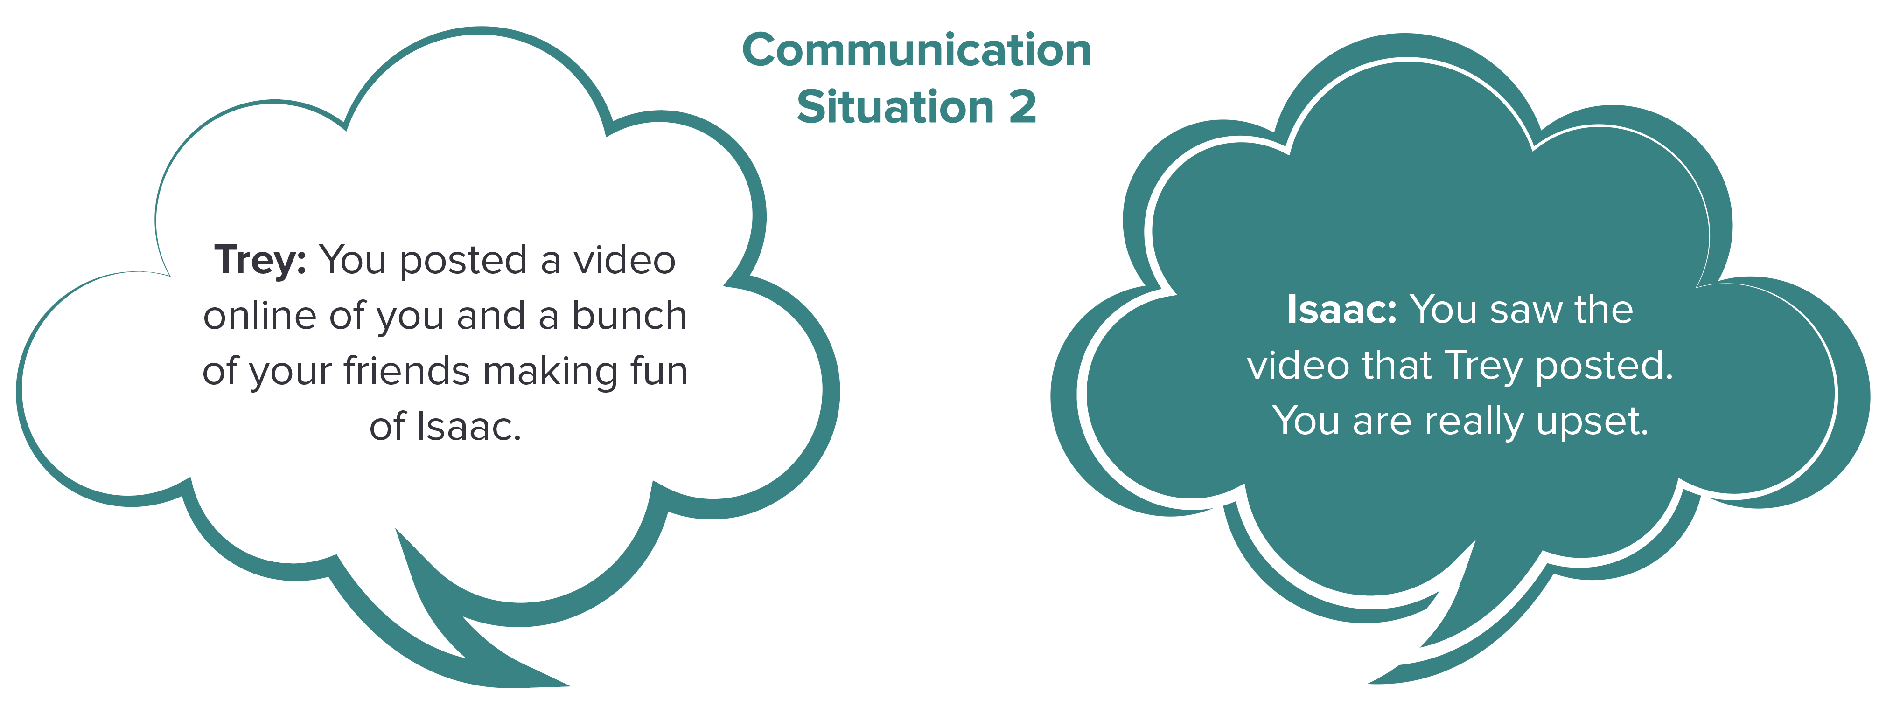
Communication Situation 2
Notes:
Facilitator Guide: Page 51
Handbook: Page 12

Slide 46
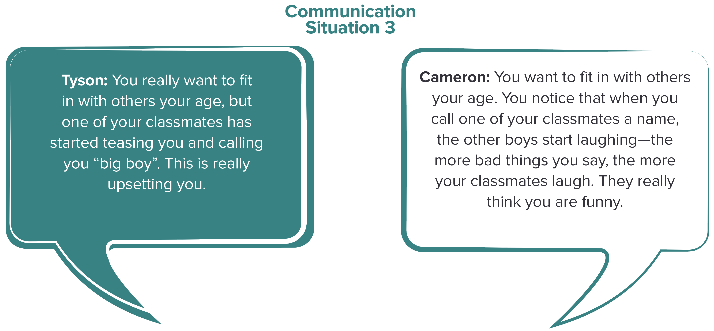
Communication Situation 3
Notes:
Facilitator Guide: Page 52
Handbook: Page 12

Slide 47
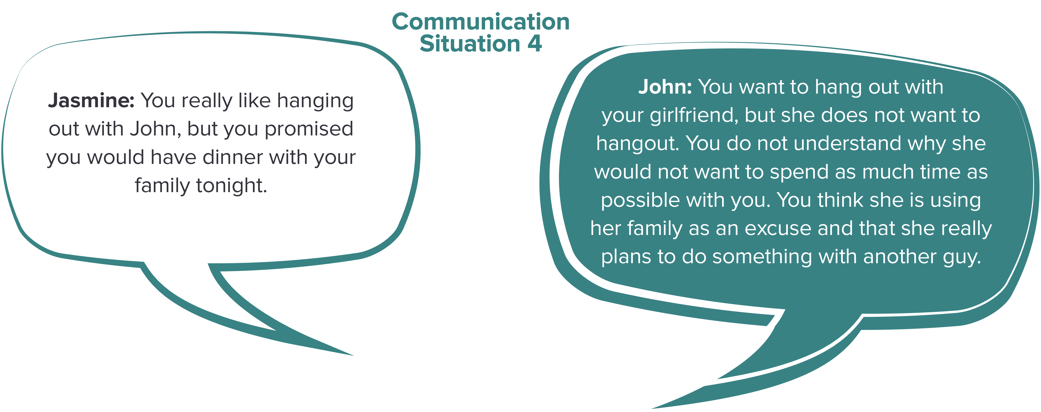
Communication Situation 4
Notes:
Facilitator Guide: Page 52
Handbook: Page 12

Slide 48
Recap & Preview
Session 4:
Healthy communication skills
Verbal and nonverbal communication
Session 5:
Unhealthy relationship behaviors
Teen dating violence
Unsafe behaviors and seeking help
Notes:
Facilitator Guide: Page 50

Slide 49

Session 5: Unhealthy & Unsafe Relationships
Notes:
Facilitator Guide: Page 53

Slide 50
Question of the Day
Who do you most respect? Why?
Type your answer into the chat box.
Notes:
Facilitator Guide: Page 54

Slide 51
Ingredients of a Healthy Friendship
What are some ways good friends treat each other?
[ingredient/characteristic]
[ingredient/characteristic]
[ingredient/characteristic]
[ingredient/characteristic]
[ingredient/characteristic]
[ingredient/characteristic]
[ingredient/characteristic]
[ingredient/characteristic]
Notes:
Facilitator Guide: Page 54
Copy and paste the completed slide from session 1 for this discussion.

Slide 52
Unhealthy Relationship Behaviors
[unhealthy relationship behavior]
[unhealthy relationship behavior]
[unhealthy relationship behavior]
[unhealthy relationship behavior]
[unhealthy relationship behavior]
[unhealthy relationship behavior]
[unhealthy relationship behavior]
[unhealthy relationship behavior]
Notes:
Facilitator Guide: Page 55
Type out students’ responses to unhealthy relationship behaviors discussion.

Slide 53
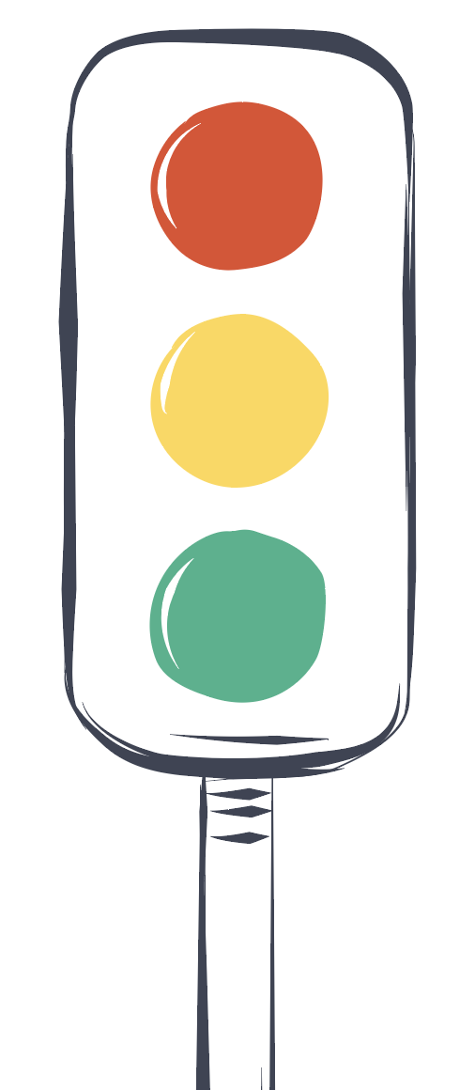
Healthy, Unhealthy, and Unsafe Behaviors
Unsafe – Things that may cause physical, sexual, or emotional harm
Unhealthy – Unhealthy behaviors between friends, between people who do not know each other, and between dating partners
Healthy – Things people do and ways people treat each other that are healthy
Notes:
Facilitator Guide: Page 55

Slide 54
What is Teen Dating Violence?
Dating violence is the use of physical, sexual, or emotional violence within a dating relationship, including stalking
It can happen in person or electronically (such as through text message, e-mail, and social media)
It happens in both casual and serious relationships and may take place between a current or past dating partner
It often starts with hurtful teasing and name calling- if it is a part of an abusive pattern, these things can lead to physical and sexual violence
Notes:
Facilitator Guide: Page 55
Handbook: Page 13

Slide 55
Understanding Teen Dating Violence
Physical dating violence is any physical act intended to scare, hurt, or injure someone
Sexual dating violence involves forcing someone to do something sexual
Sexual harassment is a form of sexual violence- it includes sexual comments or acts intended to hurt, offend, or intimidate someone else
Verbal or emotional abuse involves using threats, insults, humiliation, or other behaviors to control or isolate someone, or to harm their self-esteem
Stalking behaviors are threatening acts used by someone that is both unwanted and causes fear in the other person
Notes:
Facilitator Guide: Page 56
Handbook: Page 14

Slide 56
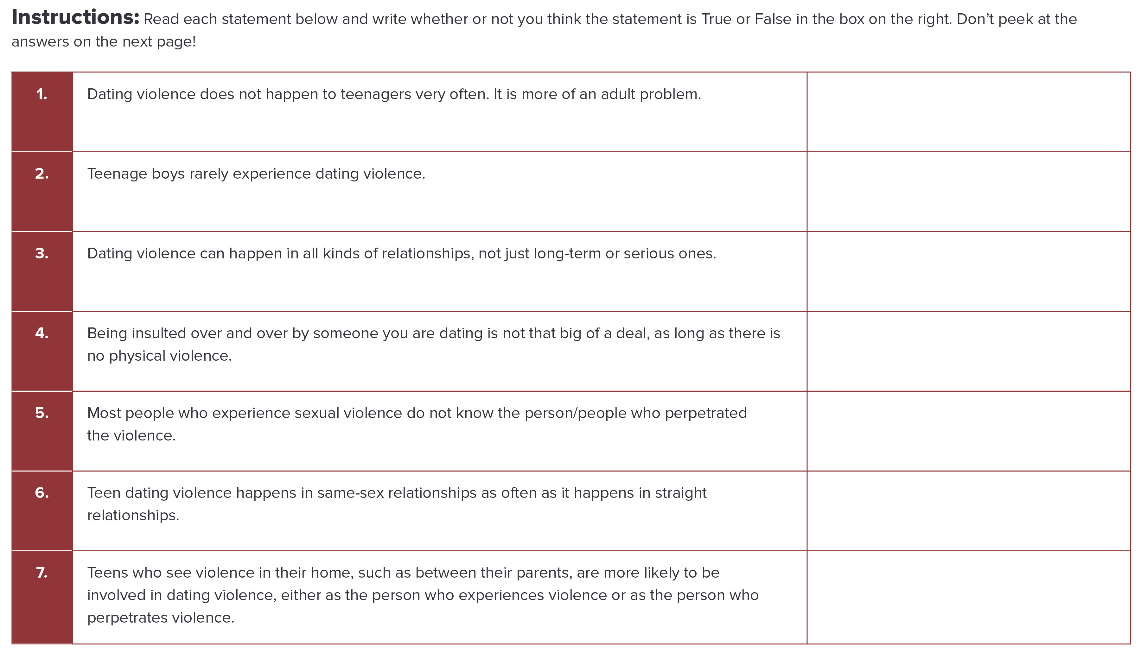
Teen Dating Violence: True or False?
Complete activity on page 16 in your handbooks.
Notes:
Facilitator Guide: Page 57
Handbook: Page 16

Slide 57
Teen Dating Violence: True or False Answers
False
False
True
False
False
True
True
Notes:
Facilitator Guide: Page 57
Handbook: Page 17

Slide 58
Red-Yellow-Green Light
Red light: STOP! Get help from a trusted adult
Yellow light: Caution/worrisome, use healthy communication skills and/or talk to a trusted adult
Green light: Healthy, Go
Notes:
Facilitator Guide: Page 59
Handbook: Page 18

Slide 59
Red-Yellow-Green Light
The girl I sit next to on the bus keeps saying she wants to touch my private parts. I told her to stop, but she keeps saying it.
I walk to lunch with a friend from my class every day. We are always cracking each other up. She is hilarious.
The guy I am dating looks through my text messages sometimes. I think he gets jealous of my guy friends.
Notes:
Facilitator Guide: Page 60
Handbook: Page 18

Slide 60
Red-Yellow-Green Light
I broke up with an old girlfriend 3 months ago, but she keeps calling my phone. I told her to stop calling and I haven’t answered her calls since. One day, she called my phone 25 times and even called my mom’s phone. She is really making me scared.
My girlfriend and I love hanging out together, but we do not like the same kind of music.
My boyfriend said he’d break up with me if I didn’t send him a “sexy” picture.
Notes:
Facilitator Guide: Page 60
Handbook: Page 18

Slide 61
Red-Yellow-Green Light
A classmate who I do not know very well keeps giving me mean looks. She looks like she wants to fight me. It is probably because I told her to shut up on the bus the other day–her voice is so annoying!
My boyfriend threatened to kill himself if we ever broke up.
Yesterday, my friend made fun of one of my pictures on social media. I know they were joking, but it still made me mad. I really like that picture.
Notes:
Facilitator Guide: Page 60
Handbook: Page 19

Slide 62
Red-Yellow-Green Light
Whenever I am upset about something, I like to talk to one of my friends. She is such a good listener.
My girlfriend and I got in a big argument yesterday. She was so mad that she forwarded a “sexy” picture of me to all my friends. That picture was supposed to be private.
I am unsure if I am gay, but I have kissed my guy friend a few times, and whenever I say I can’t hang out, he threatens to tell people about it.
Notes:
Facilitator Guide: Page 61
Handbook: Page 19

Slide 63
Red-Yellow-Green Light
Is there anything common among the unsafe, red light behaviors?
Is there anything common among the worrisome, yellow light behaviors?
Notes:
Facilitator Guide: Page 61

Slide 64
Recap & Preview
Session 5:
Unhealthy relationship behaviors
Teen dating violence
Unsafe behaviors and seeking help
Session 6:
RESPECT ME Rights
Resources and trusted adults
Tips on how to help a friend in need and how to leave an unsafe relationship
Notes:
Facilitator Guide: Page 62

Slide 65

Session 6: Staying Safe in Relationships
Notes:
Facilitator Guide: Page 63

Slide 66
Question of the Day
True or False? Most teenage victims of dating violence usually do not tell anyone that they were being hurt.
Type your answer into the chat box.
Notes:
Facilitator Guide: Page 64
This question of the day would be great as a poll that you show the results for later in the session (Facilitator Guide: Page 65) as a discussion starter.

Slide 67
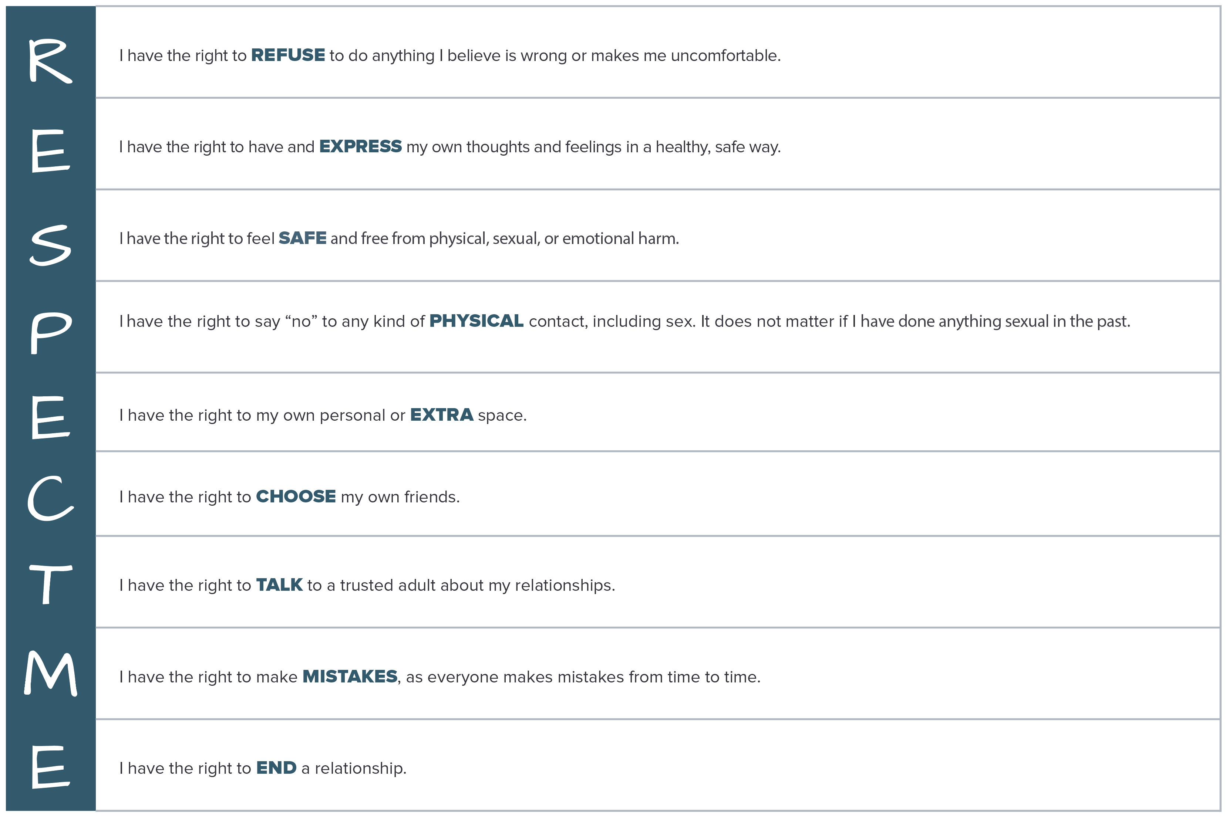
RESPECT ME Rights
Notes:
Facilitator Guide: Page 68
Handbook: Page 24

Slide 68
Helping Friends
Reach out
Listen
Believe
Do not judge
Repeat that violence or abuse is not their fault
Connect them to a resource that can help
Notes:
Facilitator Guide: Page 71
Handbook: Page 26

Slide 69
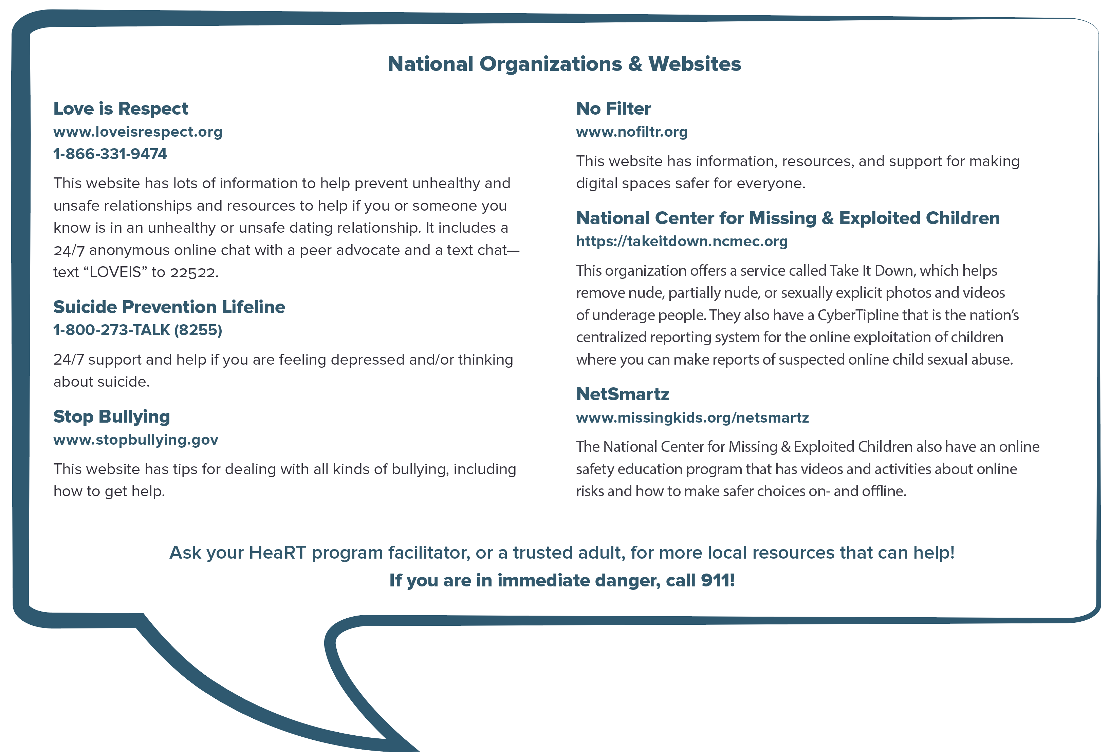
Where Can I or My Friends Get Help
Notes:
Facilitator Guide: Page 71
Handbook: Page 27
This question of the day would be great as a poll that you show the results for later in the session (Facilitator Guide: Page 65) as a discussion starter.

Slide 70
RESPECT ME Rights Rewind Performances
Each group will have the rest of the class time to develop a short performance or piece of artwork that focuses on one of the RESPECT ME Rights.
For example: a song/rap, a play, draw a picture or comic
Each group will have 5 mins to perform/present in the next class
Notes:
Facilitator Guide: Page 72

Slide 71
Recap & Preview
Session 6:
RESPECT ME Rights
Resources and trusted adults
Tips on how to help a friend in need and how to leave an unsafe relationship
Session 7:
RESPECT ME Rights presentation/performance
Parking Lot discussions
Notes:
Facilitator Guide: Page 73

Slide 72

Session 7: HeaRT Rewind
Notes:
Facilitator Guide: Page 75

Slide 73
Parking Lot
[insert topic for later discussion]
[insert topic for later discussion]
[insert topic for later discussion]
[insert topic for later discussion]
[insert topic for later discussion]
[insert topic for later discussion]
[insert topic for later discussion]
[insert topic for later discussion]
Notes:
Facilitator Guide: Page 76
Handbook: Page 28
Copy and paste your filled out parking lot slide in place of this placeholder slide.

Slide 74
CONGRATULATIONS!!!

