Slide 1
7th Grade

Slide 2

Session 1: Healthy Relationships

Slide 3
Question of the Day
If you could live anywhere in the world, where would you like to live and why?
Type your answer into the chat box.
Notes:
Facilitator Guide: Page 12
You can replace question of the day with something else you come up with. Here are a few more ideas:
If you could live anywhere in the world, where would you like to live and why?
If you could have a starring role in one movie already made, what would it be?
What has been a new favorite activity or hobby that you have started since the pandemic?

Slide 4
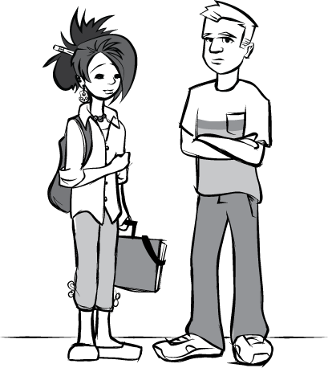
Group Agreements
Respect the privacy of others
The “no name rule”
[insert group agreement]
[insert group agreement]
[insert group agreement]
[insert group agreement]
[insert group agreement]
[insert group agreement]
Notes:
Facilitator Guide: Page 13
Handbook: Page 1
Copy and paste this slide over to the start of every session to remind students of their group agreements.

Slide 5

Parking Lot
[insert topic for later discussion]
[insert topic for later discussion]
[insert topic for later discussion]
[insert topic for later discussion]
[insert topic for later discussion]
[insert topic for later discussion]
[insert topic for later discussion]
[insert topic for later discussion]
Notes:
Facilitator Guide: Page 7
Handbook: Page 36
You can copy this slide over to the next session as you go along- for example, when you finish Session 1, copy over the parking lot slide to Session 2 so you’ll be ready to fill in more topics to come back to.

Slide 6
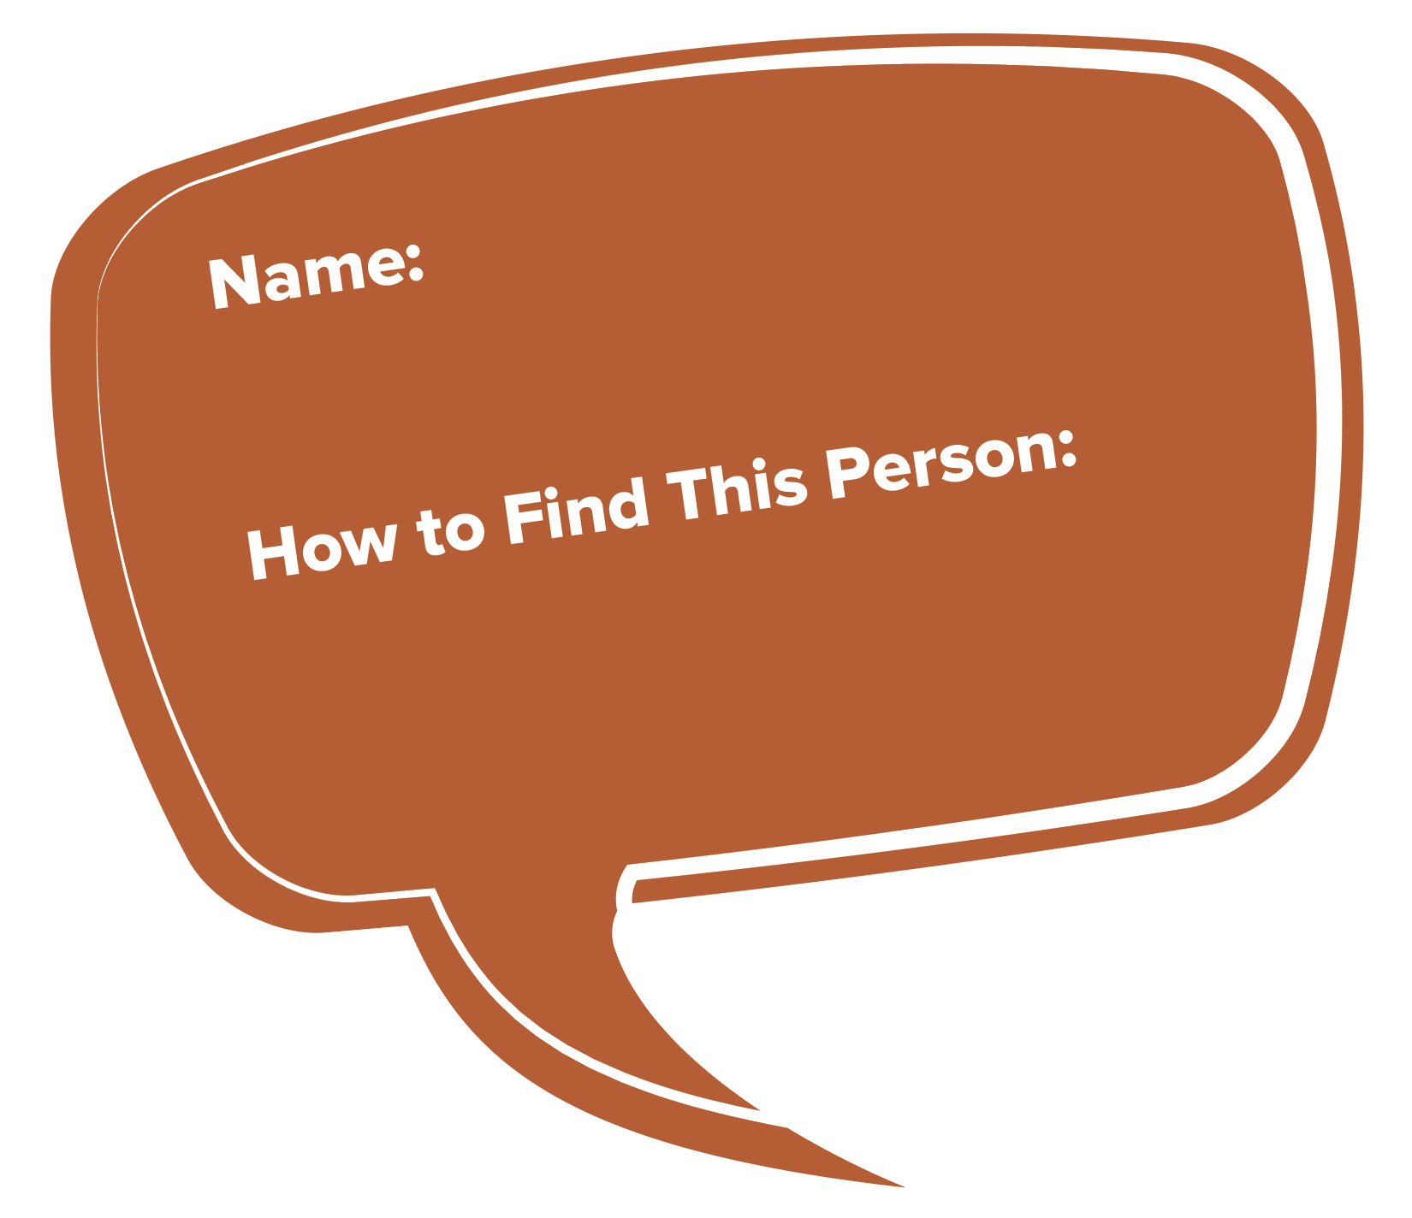
Go-To Trusted Adults
Trusted adults are people who:
  You feel comfortable talking to
  Are concerned about your safety
  You can go to if you were having trouble with a friend, a dating partner, anyone…
Notes:
Facilitator Guide: Page 14
Handbook: Page 2

Slide 7
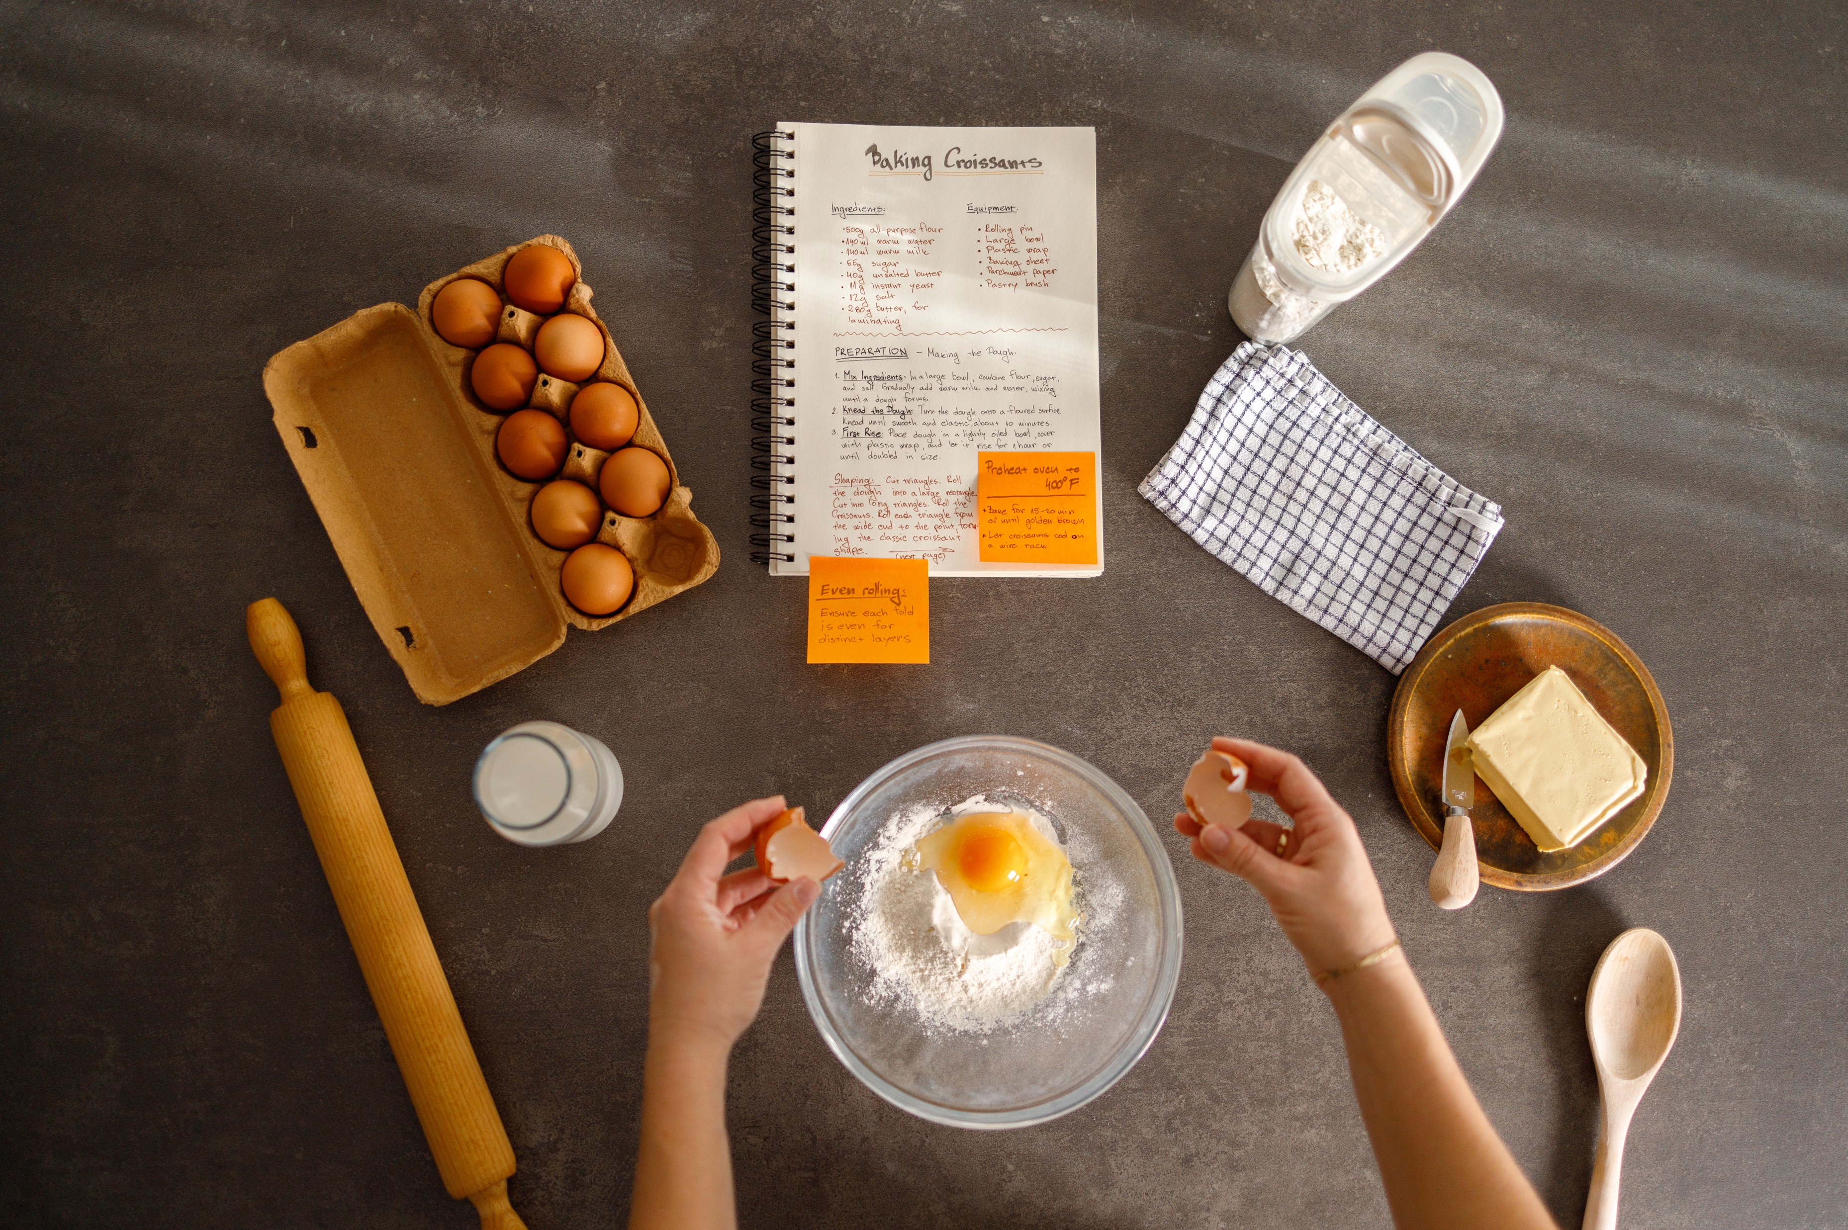
Healthy Friendship Recipe
Notes:
Facilitator Guide: Page 17

Slide 8
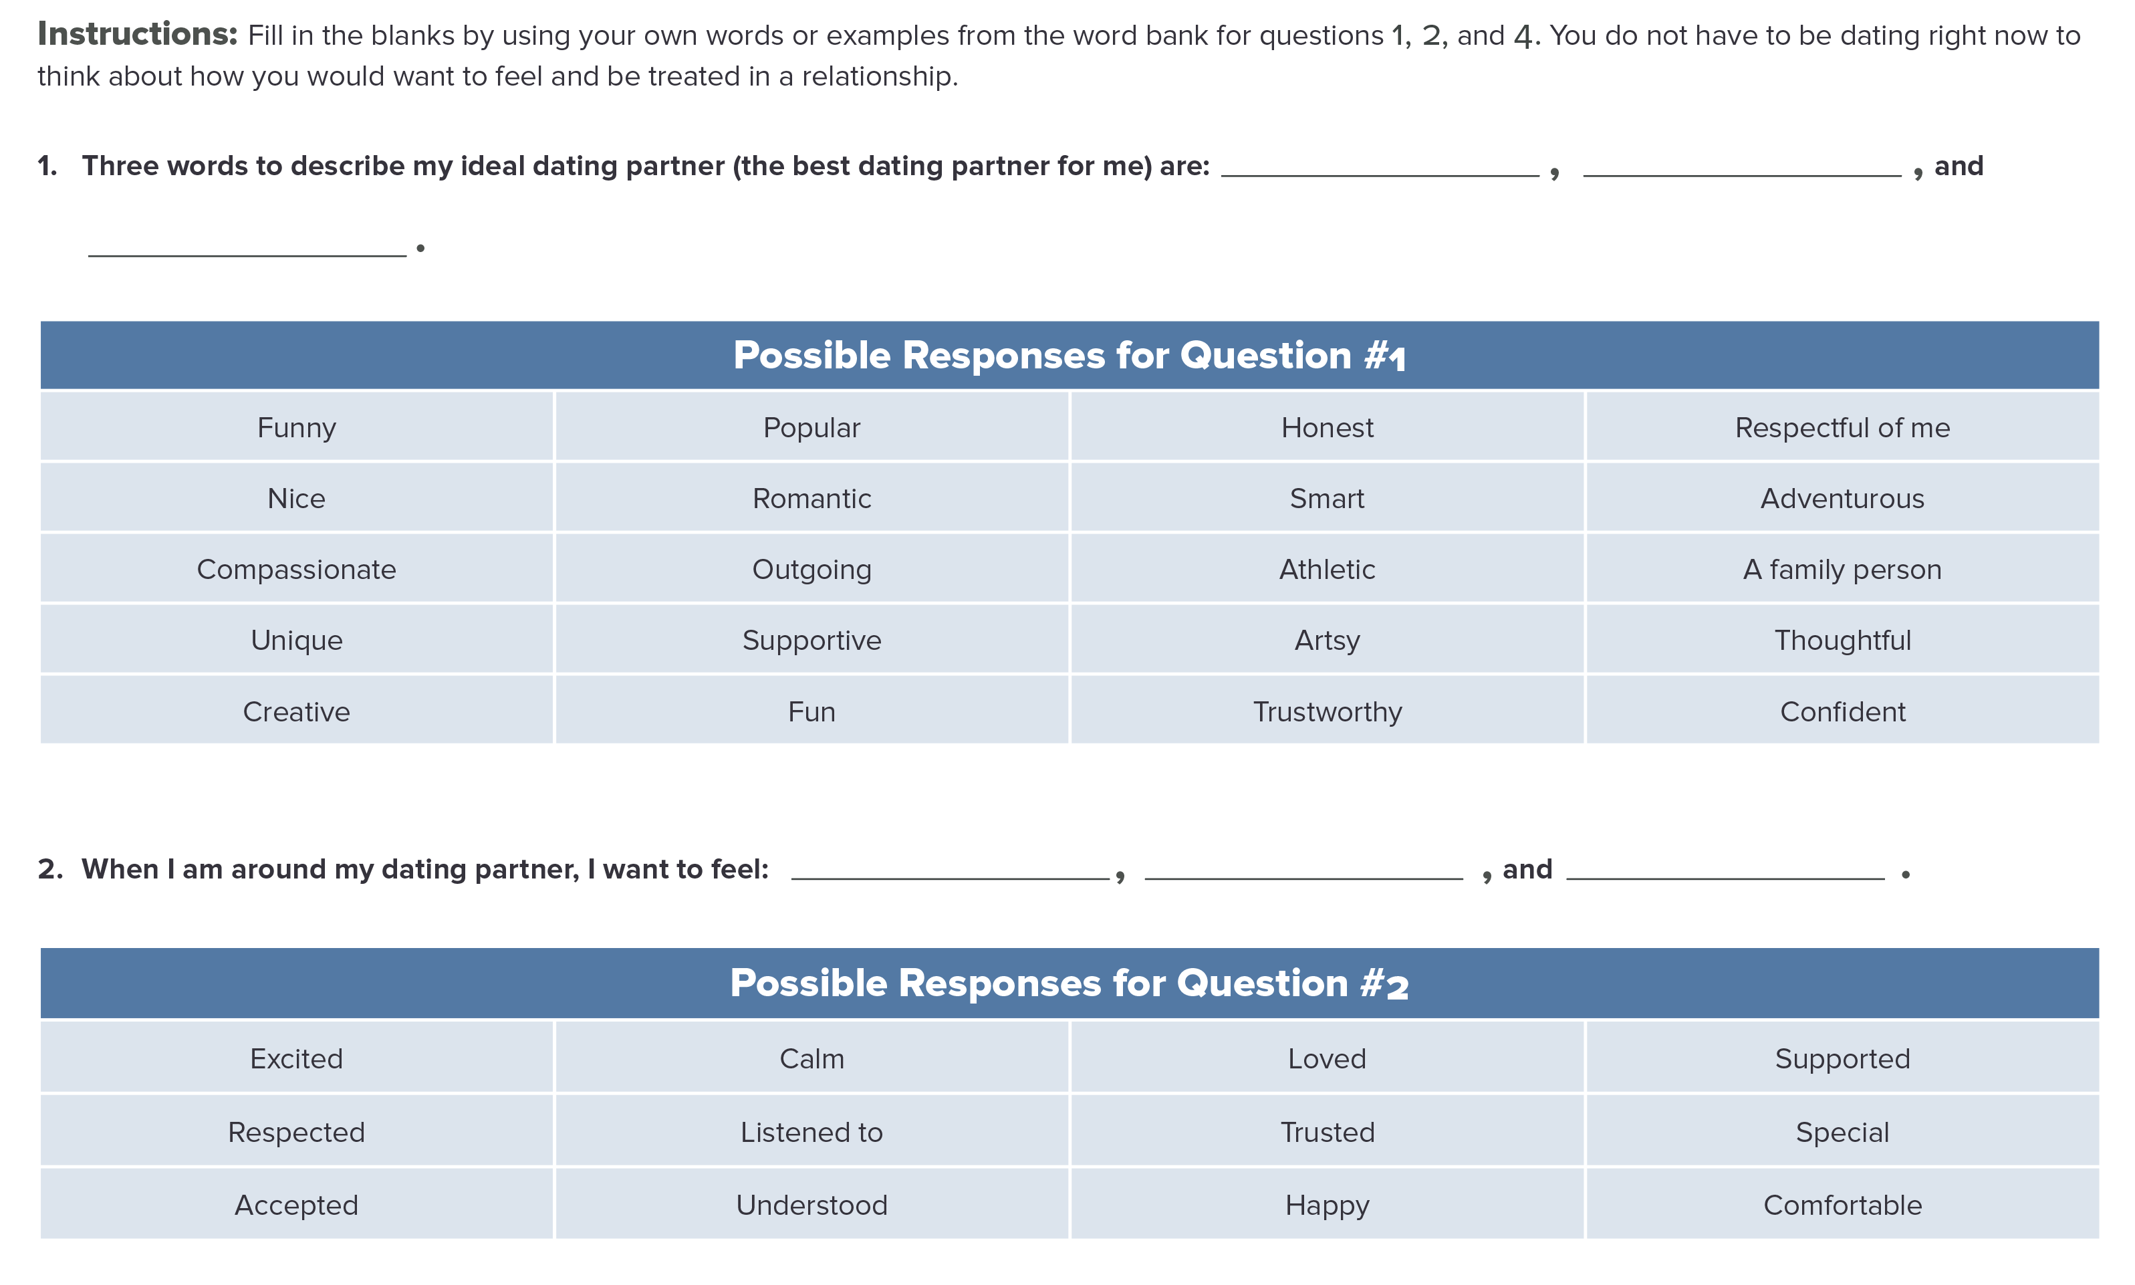
My Healthy Dating Relationship
Notes:
Facilitator Guide: Page 17
Handbook: Page 3

Slide 9
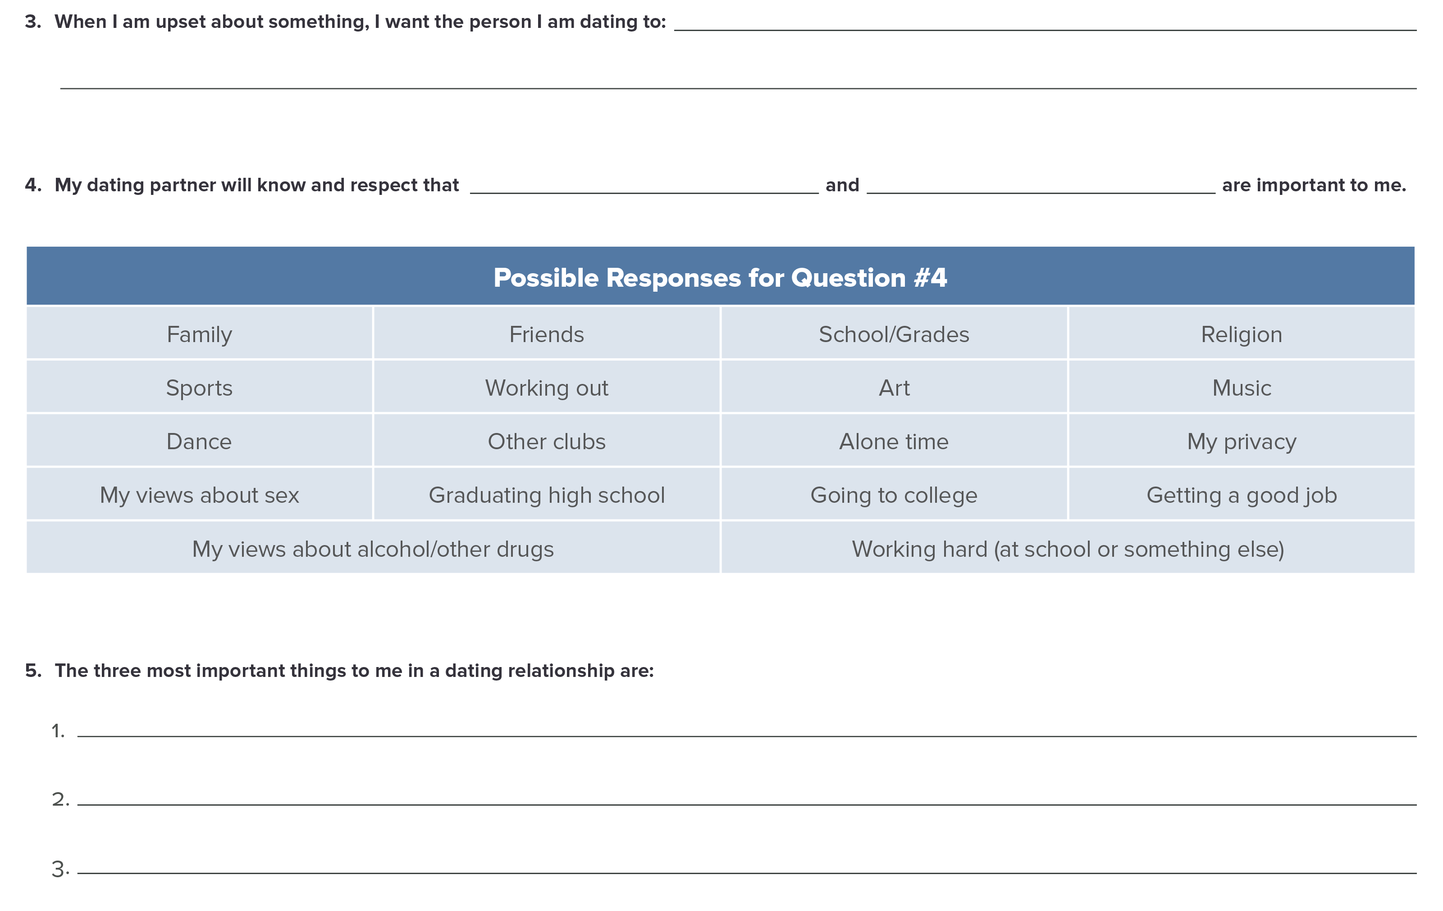
My Healthy Dating Relationship
Notes:
Facilitator Guide: Page 17
Handbook: Page 4

Slide 10
Recap & Preview
Session 1:
Go-to trusted adults
Healthy friendships
Healthy dating relationships
Session 2:
Identify, understand, and respond to feelings in a healthy and safe way
Physical clues to identify feelings
Four steps to staying in control of feelings
Notes:
Facilitator Guide: Page 19

Slide 11

Session 2: Understanding Feelings
Notes:
Facilitator Guide: Page 21

Slide 12
Question of the Day
When I am around a good friend, I want to feel __________. (Example: happy, safe. Choose your own word.)
Type your answer into the chat box.
Notes:
Facilitator Guide: Page 22

Slide 13
Feelings
When I am around a good friend, I want to feel ______________.
[insert feeling]
[insert feeling]
[insert feeling]
[insert feeling]
[insert feeling]
[insert feeling]
Notes:
Facilitator Guide: Page 22
You can highlight or circle sets of words that are similar for the discussion about words with similar meanings (page 19).

Slide 14
How Would You Feel?
Scenario 1: Your brother is really happy about getting a new job, but it means he will not be around to hang out in the afternoon.
Scenario 2: [insert scenario]
Scenario 3: [insert scenario]
Scenario 4: [insert scenario]
Scenario 5: [insert scenario]
Notes:
Facilitator Guide:: Page 24
Handbook: Page 5
Choose from the following situations (it is estimated you will have time for 4–5 situations), or create new ones that are relevant to the students in the class.
Your brother is really happy about getting a new job, but it means he will not be around to hang out in the afternoon.
It is your first day at basketball practice.
You have spent the last two weekends with your boyfriend/girlfriend and you have had a great time. But you missed your friend’s birthday party.
You and your friend both like the same person in your class. You heard from another friend that this person likes you and not your friend.
You heard that someone in your neighborhood was hurt badly in a fight.
It is the last day of the school year.
You overheard your friend calling someone else mean names.
You were asked out by someone you like. But, later that day you notice that they posted some mean comments on social media about your friend.
You got a new phone for your birthday. But, your parent says that in order to keep the phone, you have to agree to allow him/her to read all of your text messages.
You got a B on your math exam.

Slide 15
Physical Clues
Our bodies send us clues about how we are feeling. We can look for clues in two areas:
What is going on inside of our bodies
  Heart beating faster
  Upset stomach
Our body language
  Body posture
  Tone of voice
Notes:
Facilitator Guide: Page 26

Slide 16
Physical Clues
Angry Clues
[insert clue]
[insert clue]
Calm/Relaxed Clues
[insert clue]
[insert clue]
Notes:
Facilitator Guide: Page 26

Slide 17
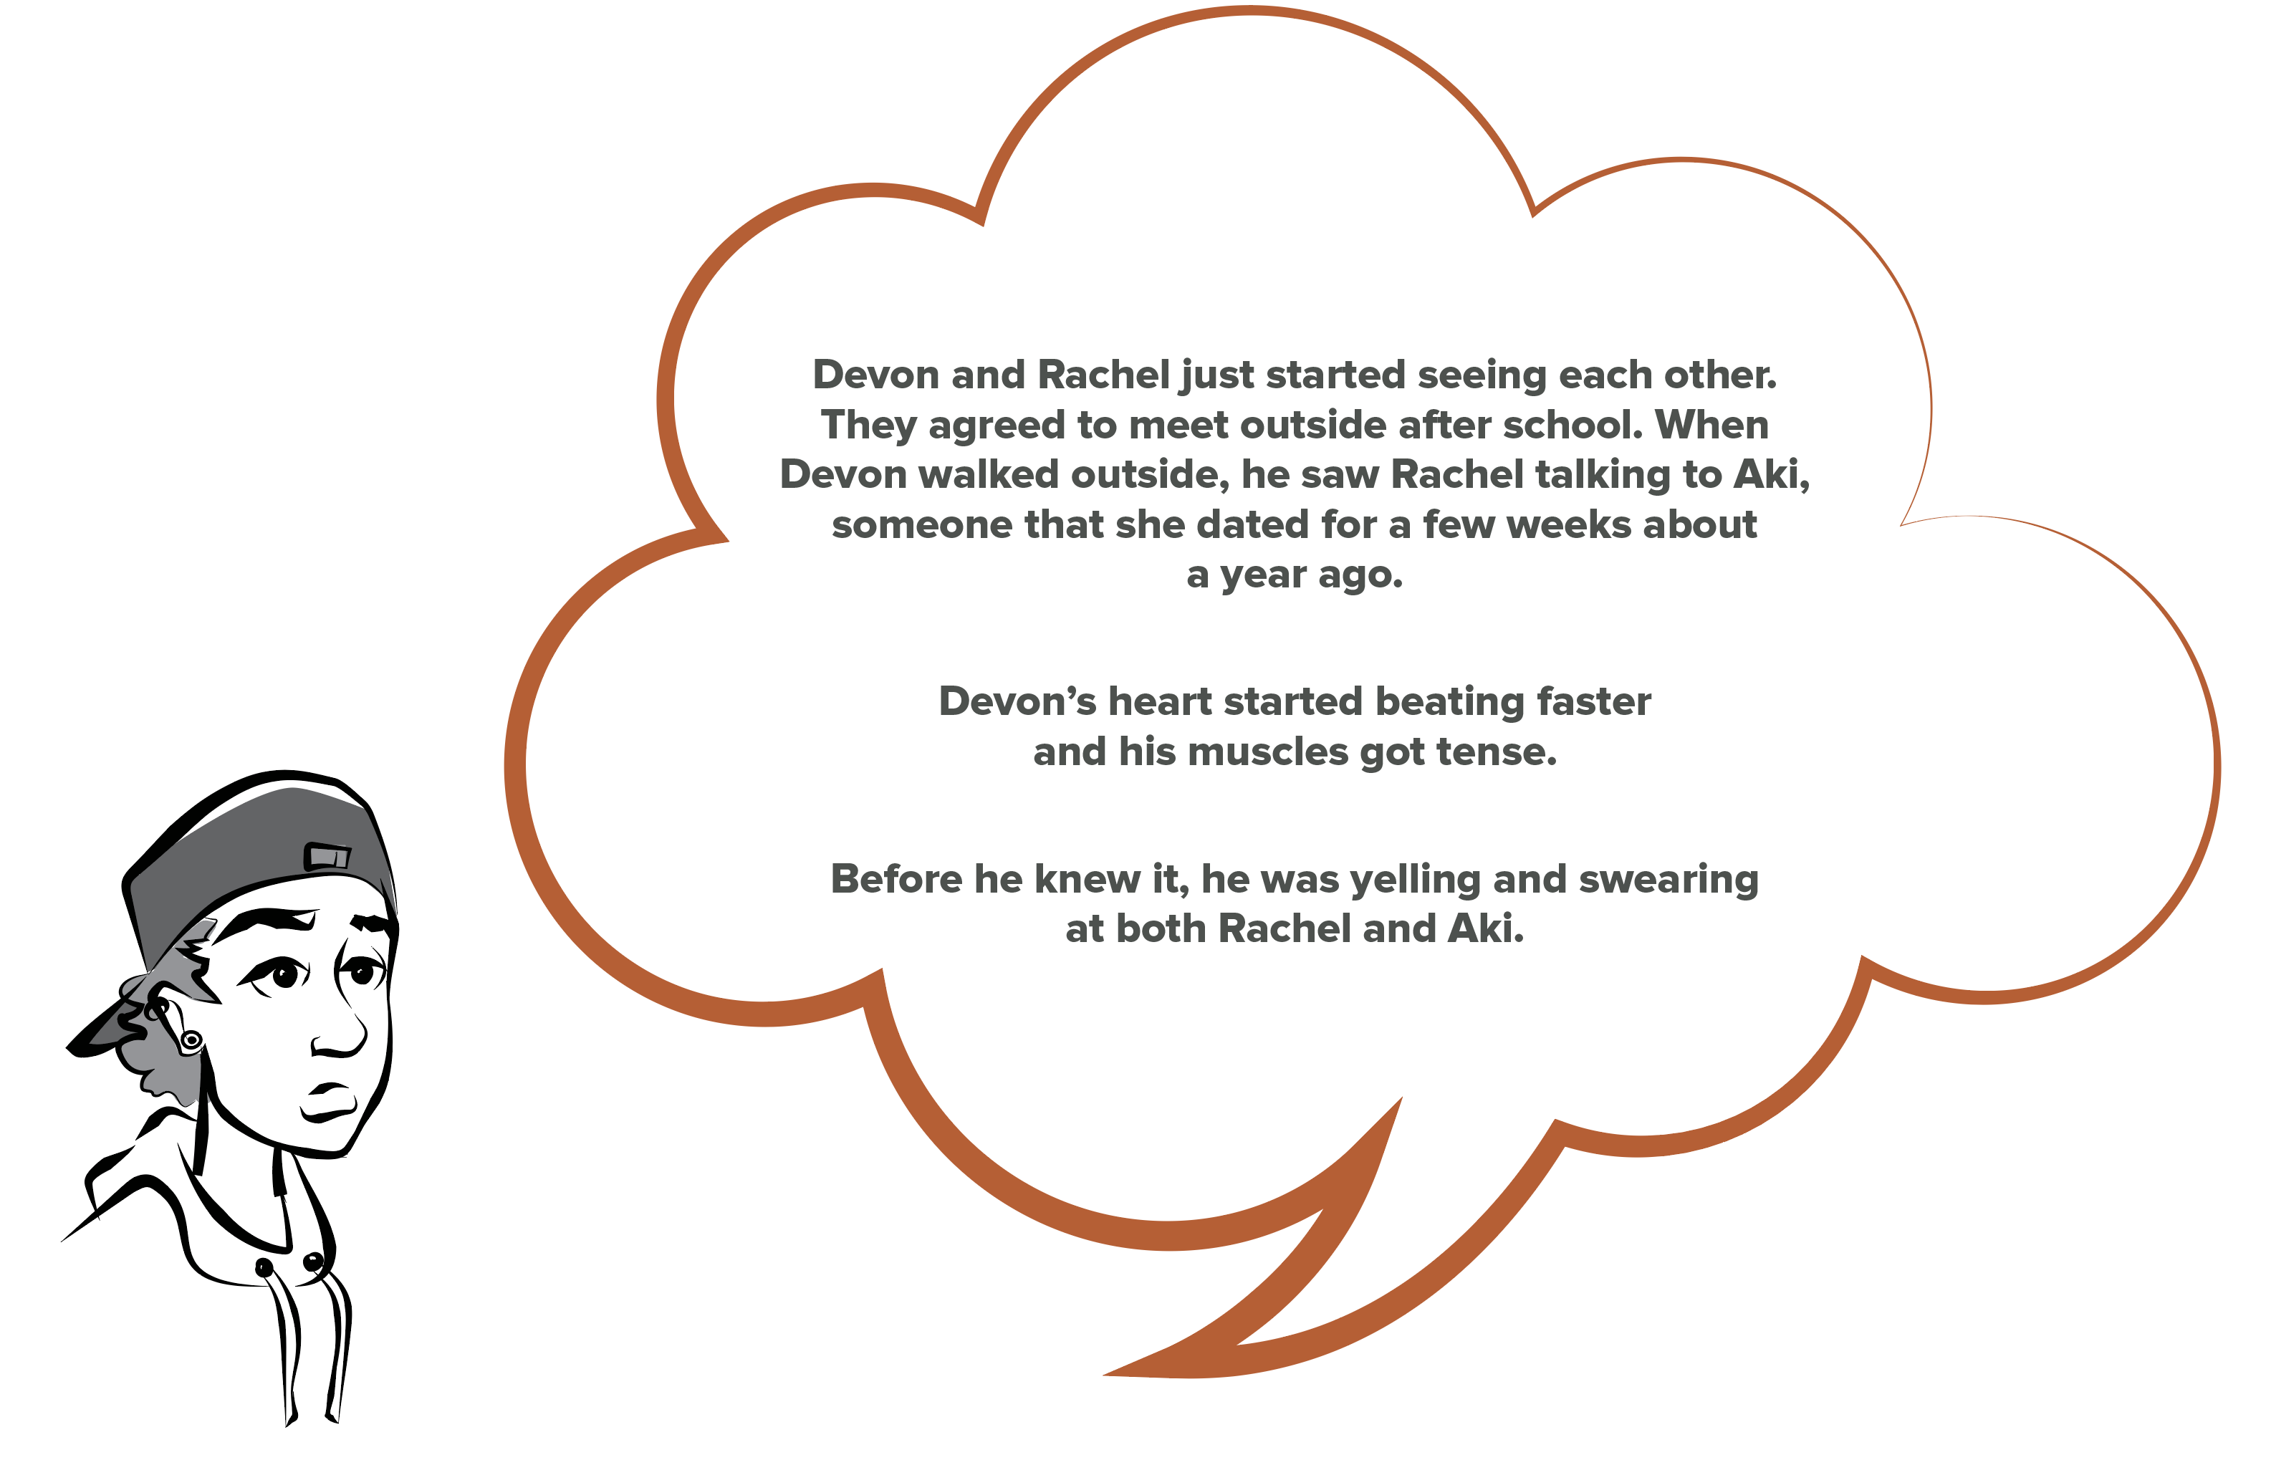
Devon’s Story
Notes:
Facilitator Guide: Page 27
Handbook: Page 6

Slide 18
Devon’s Story
Did Devon let his anger (and jealousy) take over?
What are some bad or negative things that could happen because of Devon’s angry behavior?
Notes:
Facilitator Guide: Page 27
Handbook: Page 6

Slide 19
Staying in Control of Your Feelings: 4 Steps
Notice what your body is telling you. Then, PAUSE!
Name your feeling
Pick the best way to calm down (and do it!)
Check-in
Notes:
Facilitator Guide: Page 29
Handbook: Page 7

Slide 20
Recap & Preview
Session 2:
Identify, understand, and respond to feelings in a healthy and safe way
Physical clues to identify feelings
Four steps to staying in control of feelings
Session 3:
Continue how to identify, understand, and respond to emotions/feelings in a healthy and safe way
Making healthy decisions
Notes:
Facilitator Guide: Page 30

Slide 21

Session 3: Staying in Control of Feelings & Making Healthy Decisions
Notes:
Facilitator Guide: Page 31

Slide 22
Question of the Day
True or False? Alcohol is more harmful to a teenager than it is to an adult.
Type your answer into the chat box.
Notes:
Facilitator Guide: Page 32

Slide 23
Physical Clues
Angry Clues
[insert clue]
[insert clue]
Calm/Relaxed Clues
[insert clue]
[insert clue]
Notes:
Facilitator Guide: Page 32
Copy and paste the completed “Physical Clues” slide from Session 2 here.

Slide 24
Staying in Control of Your Feelings: 4 Steps
Notice what your body is telling you. Then, PAUSE!
Name your feeling
Pick the best way to calm down (and do it!)
Check-in
Notes:
Facilitator Guide: Page 32
Handbook: Page 7

Slide 25
Calming Down
Healthy ways to calm down:
Take deep breaths
Use positive self-talk (things we can say or think that can help us calm down)
Doing something physically active or relaxing
Talk to someone you trust
Notes:
Facilitator Guide: Page 32

Slide 26
Negative Self-Talk, Positive Self-Talk
Four goals were scored by the other team when Winnie was the soccer goalie.
Ming got a text from his friend Layla. It said, “I can’t make the movies again, sorry.” It is the second time this week that Layla has cancelled.
Notes:
Facilitator Guide: Page 34
Handbook: Page 8
Options for the Negative Self-Talk, Positive Self-Talk activities: Do it together as a class OR use breakout group function in Zoom (or other virtual platform) and give students 5 minutes with their group or partner to come up with answers to then share with the class.

Slide 27
We Enjoy…
Physically Active
[activity]
[activity]
[activity]
[activity]
[activity]
[activity]
[activity]
[activity]
Relaxing
[activity]
[activity]
[activity]
[activity]
[activity]
[activity]
[activity]
[activity]
Notes:
Facilitator Guide: Page 36
Handbook: Page 9
Go through students’ responses in the chatbox and fill in this slide as students point out which type of activity each response belongs under.

Slide 28
Question of the Day
True or False? Alcohol is more harmful to a teenager than it is to an adult.
TRUE
Notes:
Facilitator Guide: Page 37

Slide 29

Alcohol and Drugs
Alcohol is more harmful to teenagers than it is to adults because teenager’s brains and bodies are still developing.
Drinking alcohol, or doing any other drugs, during this time of growth can lead to lifelong damage in the way your brain works. It can lead to learning problems and can change your:
  Memory
  Motor skills (the way you move)
  Coordination
Notes:
Facilitator Guide: Page 37

Slide 30
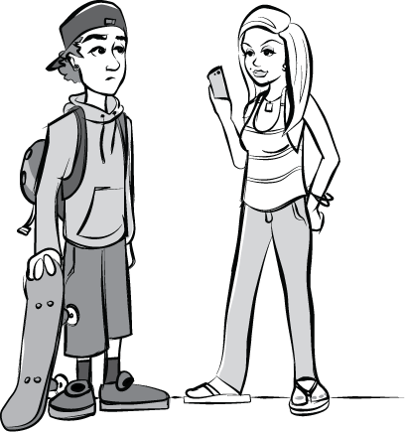
Alcohol and Drugs (continued)
People who start drinking earlier in life are more likely to develop an alcohol use disorder later in life.
Notes:
Facilitator Guide: Page 39

Slide 31
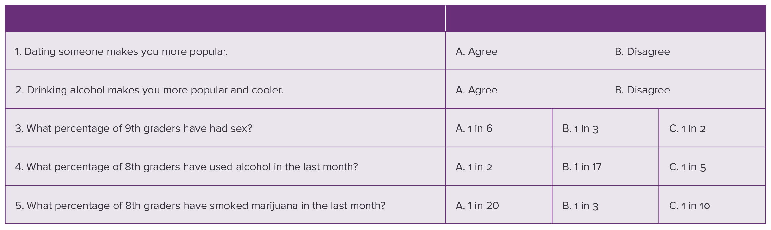
My Views
Notes:
Facilitator Guide: Page 42
You can use the poll function and have students answer one question at a time or answer them all at once and review the answers together afterwards.

Slide 32
Recap & Preview
Session 3:
Continue how to identify, understand, and respond to emotions/feelings in a healthy and safe way
Making healthy decisions
Session 4:
Healthy communication skills
Verbal and nonverbal communication
Notes:
Facilitator Guide: Page 41

Slide 33

Session 4: Healthy Communication
Notes:
Facilitator Guide: Page 43

Slide 34
Question of the Day
Open your handbook to page 4. Look at question #4. You wrote two things that you want the person you are dating to respect about you.
Write down one or two ways that using alcohol or drugs may affect these things that are important to you.
Notes:
Facilitator Guide: Page 44
Handbook: Page 4

Slide 35
Ingredients of a Healthy Friendship
What are some ways good friends treat each other?
[ingredient/characteristic]
[ingredient/characteristic]
[ingredient/characteristic]
[ingredient/characteristic]
[ingredient/characteristic]
[ingredient/characteristic]
[ingredient/characteristic]
[ingredient/characteristic]
Notes:
Facilitator Guide: Page 44
Copy and paste the completed slide from session 1 for this discussion.

Slide 36


Two ways we can communicate
Nonverbal communication
  Things we do not say directly
  Messages we send with our body and facial expressions
  Examples: eye contact, gestures, posture, and body movements
Verbal communication
  Things we say and how we say them
  Example: tone of voice
Notes:
Facilitator Guide: Page 45

Slide 37
Nonverbal Clues
What if you can only communicate non-verbally?
A few volunteers will act out scenarios and we will all guess what they are trying to tell us.
Note things like eye contact, hand signs, or other physical gestures.
Notes:
Facilitator Guide: Page 45
Replace the Silent Line-up activity with a type of charades. Pick a few volunteers and give them scenarios (by messaging them privately) to act out using gestures. Or you can act out a few scenarios and have students guess what your body language and gestures tell them. Example scenarios:
Worried
Excited
Bored

Slide 38
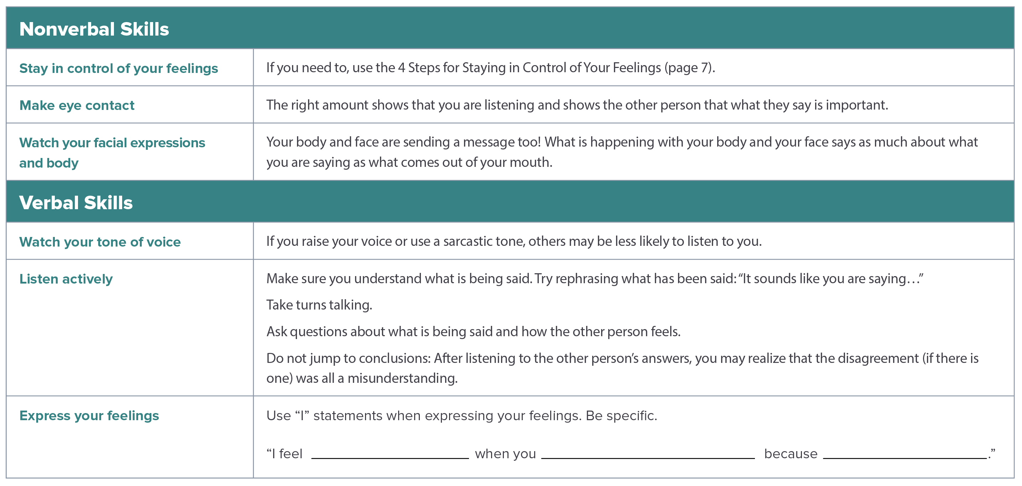
Skills for Healthy Communication
Notes:
Facilitator Guide: Page 46
Handbook: Page 10

Slide 39
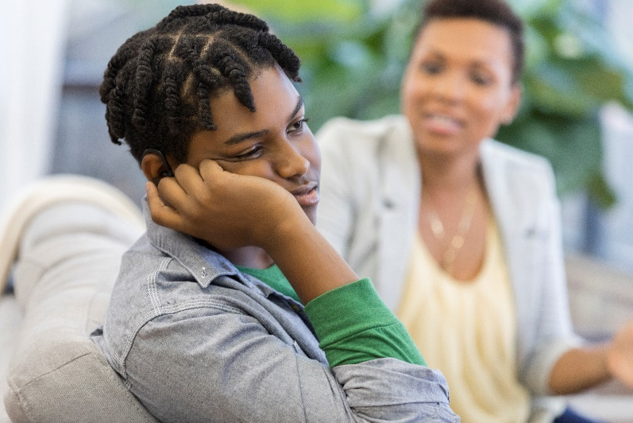
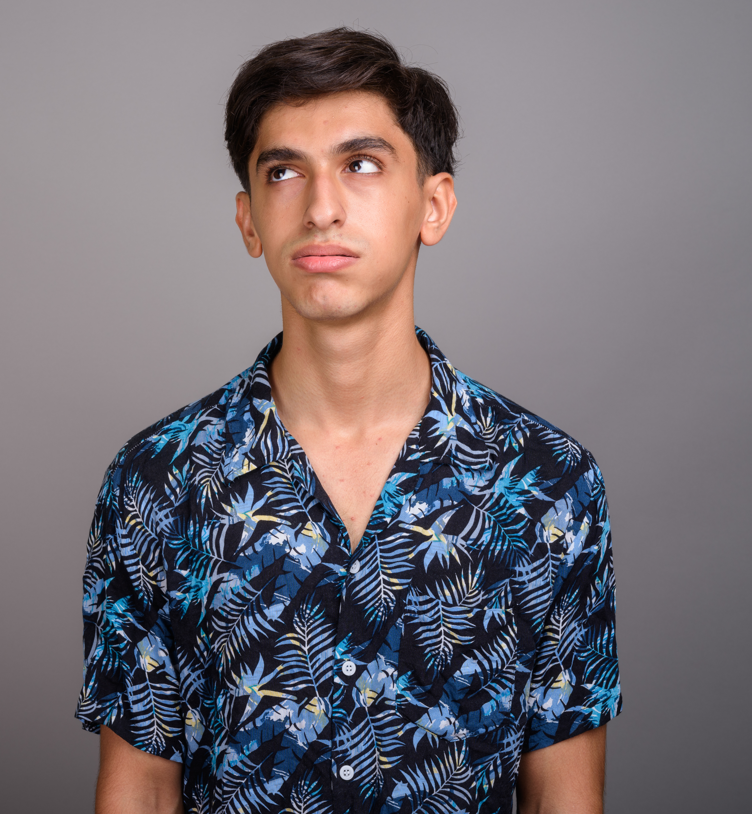
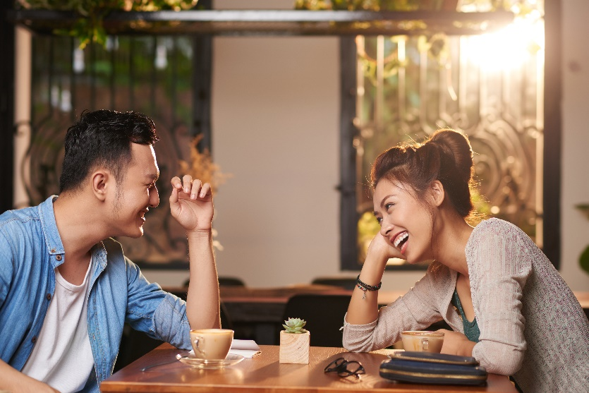
Nonverbal Communication Skills
People send messages when they cross their arms, shake their head, point to something, tap their fingers, smile, or roll their eyes.
Notes:
Facilitator Guide: Page 47
Handbook: Page 10
Examples:
Man and woman are leaning towards each other and making eye contact to show they are really interested in and listening.
Boy is looking away and showing disinterest or boredom while his mom is talking to him.
Boy is rolling his eyes.

Slide 40
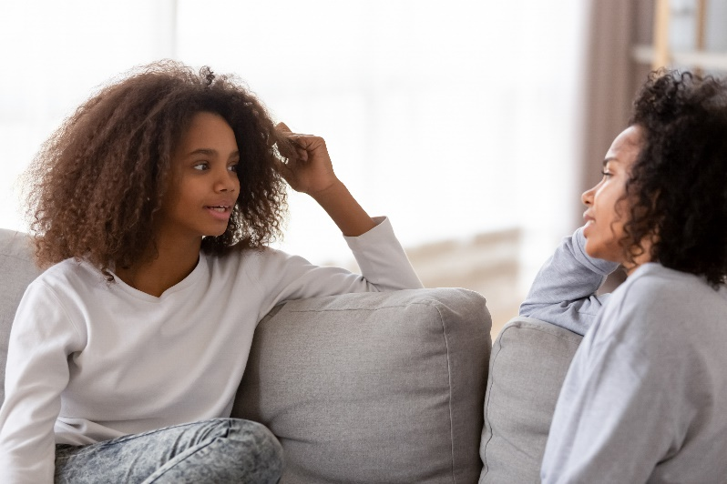
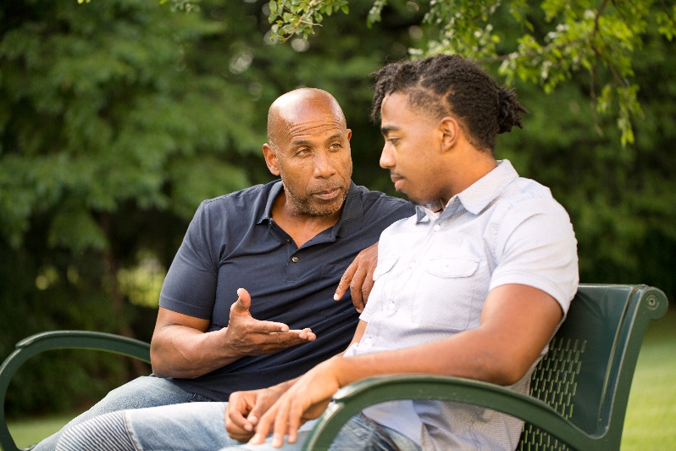
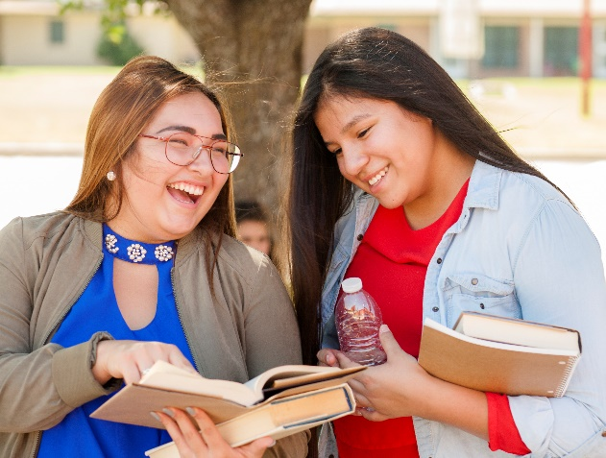
Verbal Communication Skills
Tone of voice
Active listening
  Rephrase what has been said
  Take turns talking
  Ask questions about what is said and how the other person feels
Notes:
Facilitator Guide: Page 47
Handbook: Page 10

Slide 41
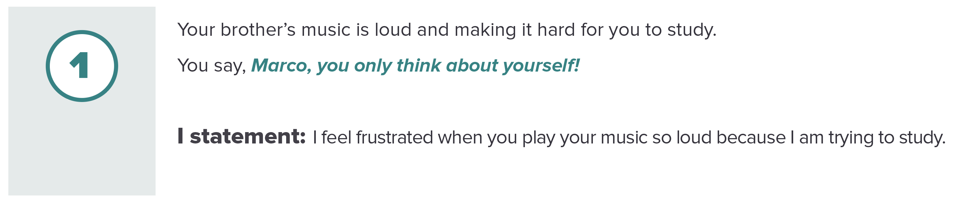
“I” Am Important
“I” statements…
Are a way to clearly express how you feel
Make it easier to express how you feel because you are just talking about yourself
Let’s practice:
Notes:
Facilitator Guide: Page 49
Handbook: Page 11

Slide 42
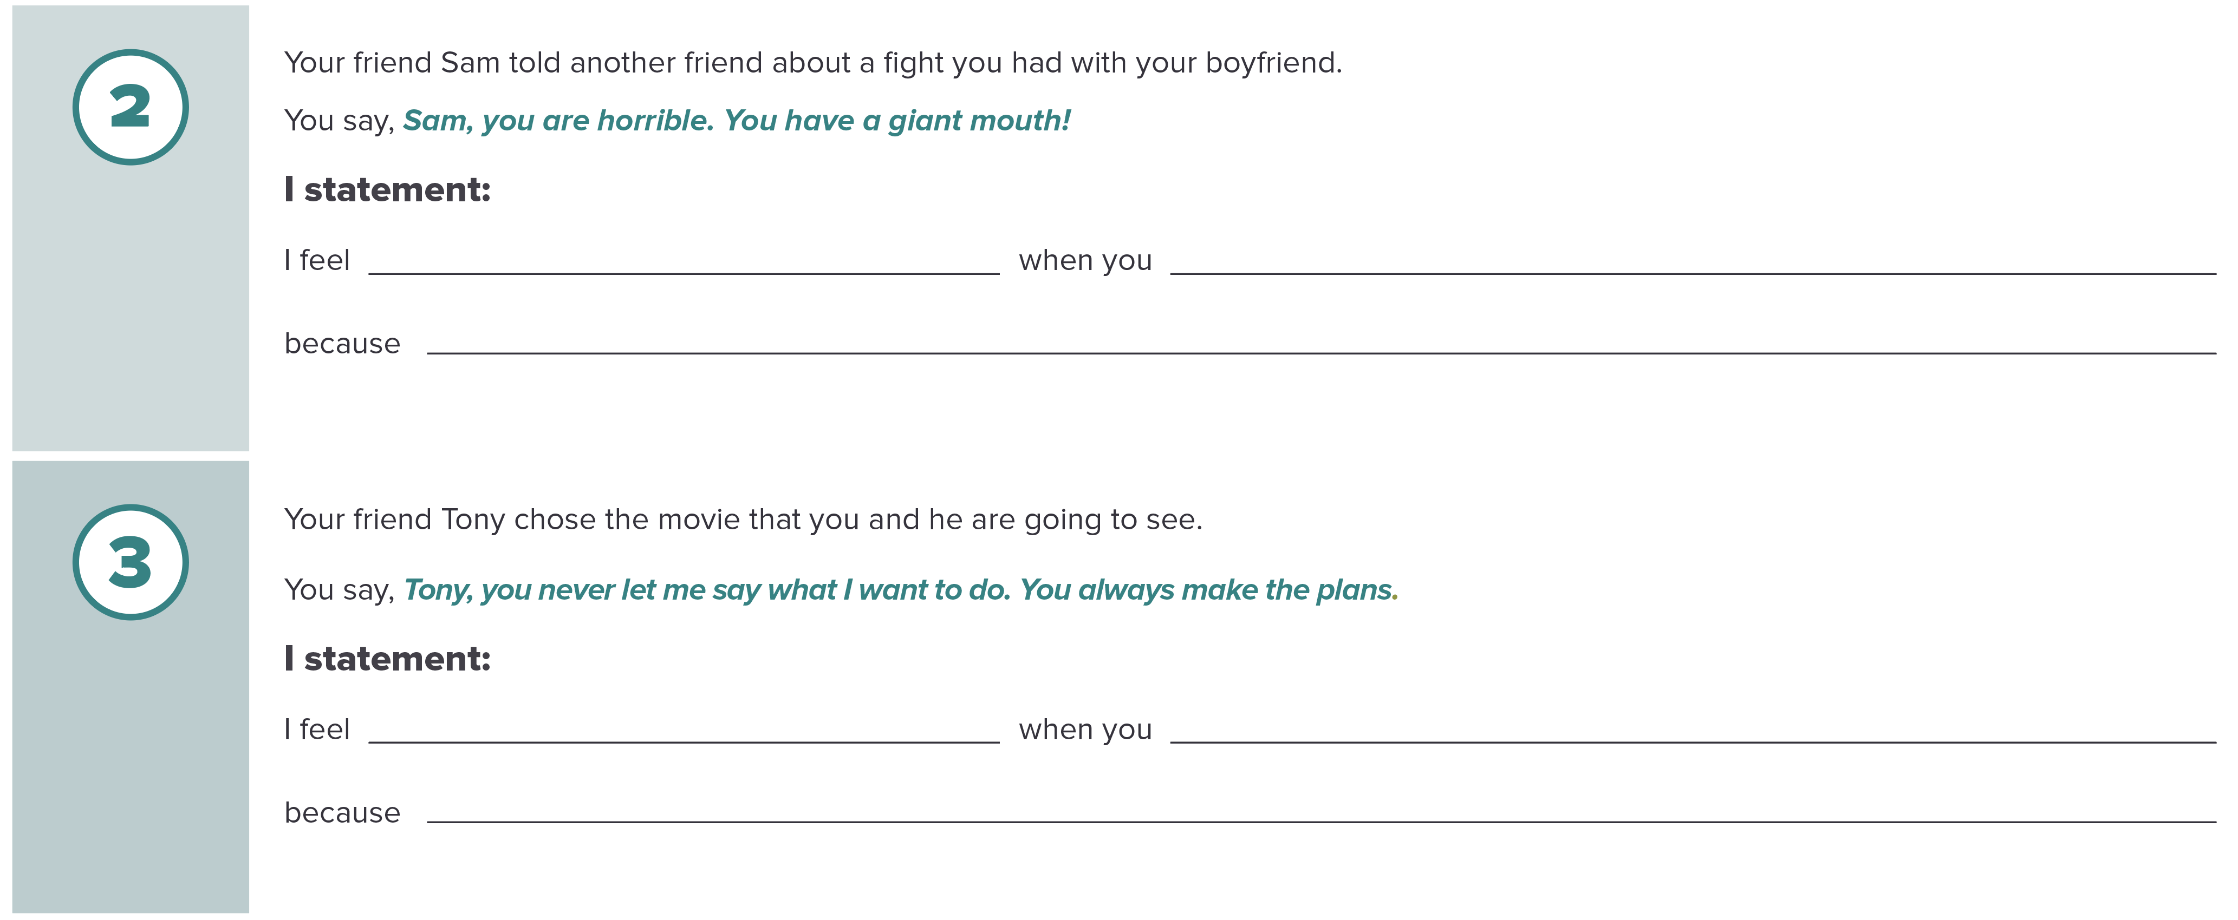
“I” Am Important (continued)
Notes:
Facilitator Guide: Page 49
Handbook: Page 11

Slide 43
Communication Practice
We will practice healthy communication skills with four scenarios
Each scenario:
  Two volunteers will act out the scenario (girls do not have to play girls and boys do not have to play boys)
  Actors will try to use each of the healthy communication skills at least once
  The rest of the class will be observers who will check off which healthy communication skills were used during the role-plays on page 12 of your handbooks (pick only one actor for the checklist)
Notes:
Facilitator Guide: Page 50
Handbook: Page 12
Pick two volunteers for each of the four scenarios and direct/private message them their scenario. Allow the pairs of volunteers to join a separate breakout session or virtual meeting so they have a few minutes to go over their communication situations. After a few minutes, end their breakout session so they can join the rest of the class.

Slide 44
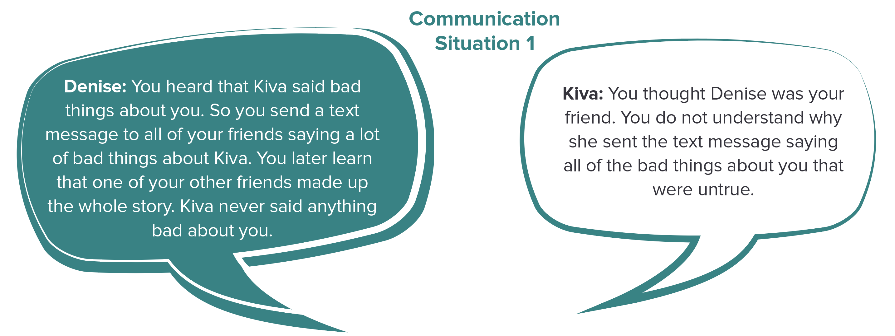
Communication Situation 1
Notes:
Facilitator Guide: Page 52
Handbook: Page 12

Slide 45
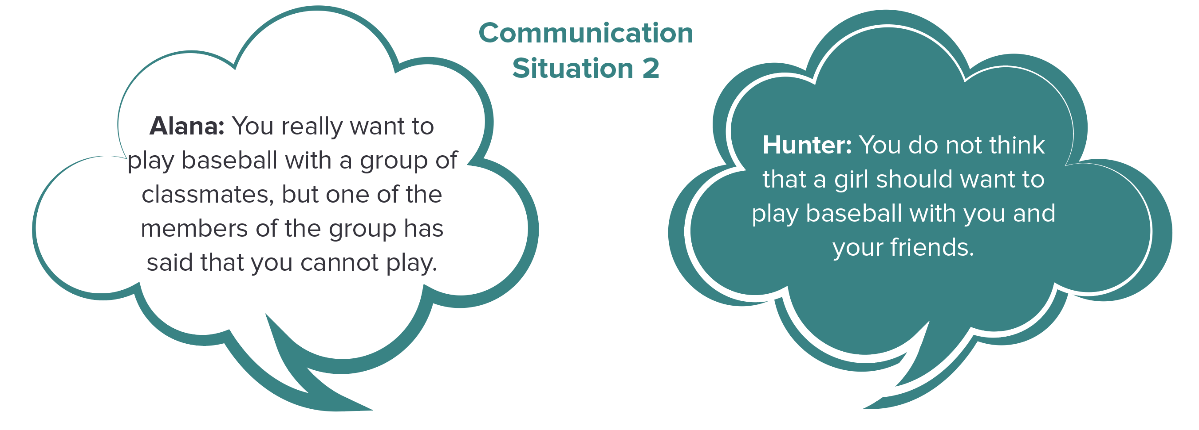
Communication Situation 2
Notes:
Facilitator Guide: Page 52
Handbook: Page 12

Slide 46
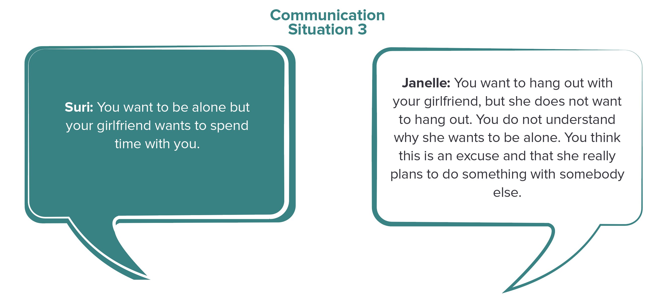
Communication Situation 3
Notes:
Facilitator Guide: Page 53
Handbook: Page 12

Slide 47
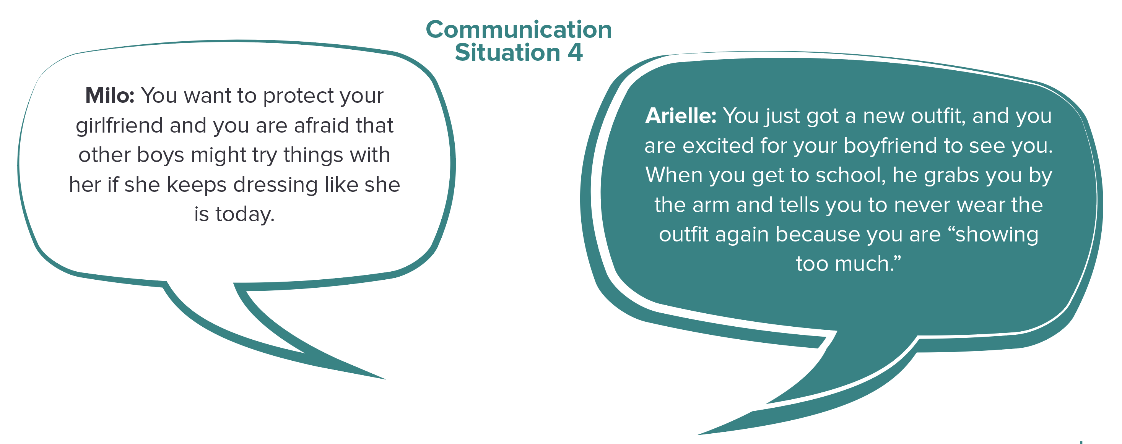
Communication Situation 4
Notes:
Facilitator Guide: Page 53
Handbook: Page 12

Slide 48
Recap & Preview
Session 4:
Healthy communication skills
Verbal and nonverbal communication
Session 5:
Unhealthy relationship behaviors
Teen dating violence
Unsafe behaviors and seeking help
Notes:
Facilitator Guide: Page 51

Slide 49

Session 5: Unhealthy & Unsafe Relationships
Notes:
Facilitator Guide: Page 55

Slide 50
Question of the Day
Who do you most respect? Why?
Type your answer into the chat box.
Notes:
Facilitator Guide: Page 56

Slide 51
Ingredients of a Healthy Friendship
What are some ways good friends treat each other?
[ingredient/characteristic]
[ingredient/characteristic]
[ingredient/characteristic]
[ingredient/characteristic]
[ingredient/characteristic]
[ingredient/characteristic]
[ingredient/characteristic]
[ingredient/characteristic]
Notes:
Facilitator Guide: Page 56
Copy and paste the completed slide from session 1 for this discussion.

Slide 52
Unhealthy Relationship Behaviors
[unhealthy relationship behavior]
[unhealthy relationship behavior]
[unhealthy relationship behavior]
[unhealthy relationship behavior]
[unhealthy relationship behavior]
[unhealthy relationship behavior]
[unhealthy relationship behavior]
[unhealthy relationship behavior]
Notes:
Facilitator Guide: Page 56
Type out students’ responses to unhealthy relationship behaviors discussion.

Slide 53
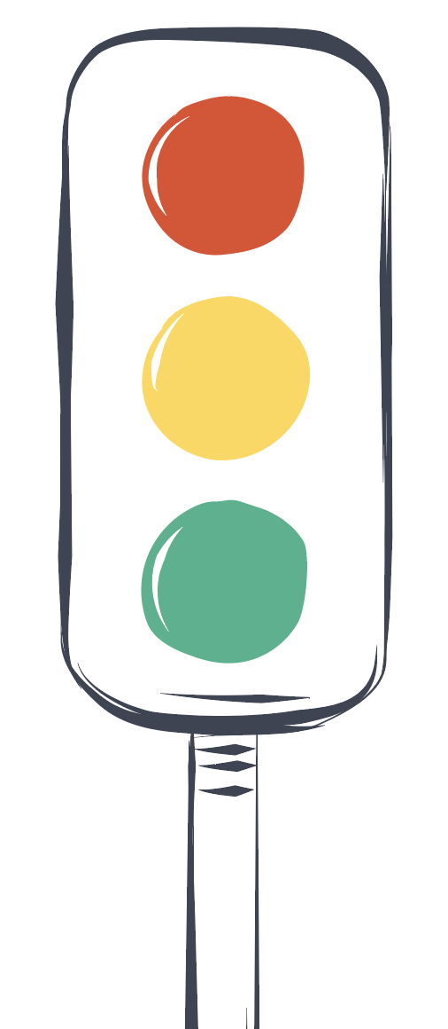
Healthy, Unhealthy, and Unsafe Behaviors
Unsafe – Things that may cause physical, sexual, or emotional harm
Unhealthy– Unhealthy behaviors between friends, between people who do not know each other, and between dating partners
Healthy– Things people do and ways people treat each other that are healthy
Notes:
Facilitator Guide: Page 57

Slide 54
What is Teen Dating Violence?
Dating violence is the use of physical, sexual, or emotional violence within a dating relationship, including stalking
It can happen in person or electronically (such as through text message, e-mail, and social media)
It happens in both casual and serious relationships and may take place between a current or past dating partner
It often starts with hurtful teasing and name calling- if it is a part of an abusive pattern, these things can lead to physical and sexual violence
Notes:
Facilitator Guide: Page 58
Handbook: Page 13

Slide 55
Understanding Teen Dating Violence
Physical dating violence is any physical act intended to scare, hurt, or injure someone
Sexual dating violence involves forcing someone to do something sexual
Sexual harassment is a form of sexual violence- it includes sexual comments or acts intended to hurt, offend, or intimidate someone else
Verbal or emotional abuse involves using threats, insults, humiliation, or other behaviors to control or isolate someone, or to harm their self-esteem
Stalking behaviors are threatening acts used by someone that is both unwanted and causes fear in the other person
Notes:
Facilitator Guide: Page 58
Handbook: Page 14

Slide 56
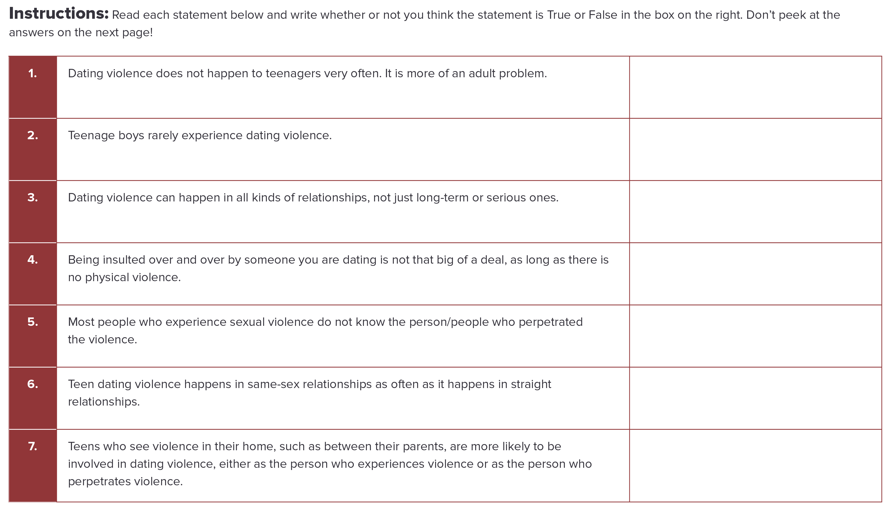
Teen Dating Violence: True or False?
Complete activity on page 16 in your handbooks.
Notes:
Facilitator Guide: Page 59
Handbook: Page 16

Slide 57
Teen Dating Violence: True or False Answers
False
False
True
False
False
True
True
Notes:
Facilitator Guide: Page 59
Handbook: Page 17

Slide 58
Red-Yellow-Green Light
Red light: STOP! Get help from a trusted adult
Yellow light: Caution/worrisome, use healthy communication skills and/or talk to a trusted adult
Green light: Healthy, Go
Notes:
Facilitator Guide: Page 61-64
Handbook: Page 18

Slide 59
Red-Yellow-Green Light
I have been going out with my boyfriend for a few weeks. We got into a disagreement about what we were going to do on Friday night, but we talked through it and were nice to each other even though we did not agree.
  GREEN LIGHT
I got into my first argument with my boyfriend. It was about what movie to watch. I called him a jerk and then apologized.
  YELLOW LIGHT
I saw my girlfriend going through my text messages.
  YELLOW or RED LIGHT
My partner and I love hanging out together, but we do not like the same kind of music.
  GREEN LIGHT
Notes:
Facilitator Guide: Page 62
Handbook: Page 18

Slide 60
Red-Yellow-Green Light
My boyfriend threatened to kill himself if we ever broke up.
  RED LIGHT
Every time I wear shorts, my boyfriend yells at me, calls me fat and tells me to change into pants. I stopped wearing shorts because I am afraid that he will yell at me again.
  RED LIGHT
When I was with my girlfriend, I let her take a “sexy” picture of me. When we broke up, she sent it to her friends. That picture was supposed to just stay between us.
  RED LIGHT
Notes:
Facilitator Guide: Page 62
Handbook: Page 18

Slide 61
Red-Yellow-Green Light
When I get into an argument with my partner, they threaten to “out” me to people at school who do not know I am gay.
  RED LIGHT
Notes:
Facilitator Guide: Page 62
Handbook: Page 18

Slide 62
Red-Yellow-Green Light
Is there anything common among the unsafe, red light behaviors?
Is there anything common among the worrisome, yellow light behaviors?
Notes:
Facilitator Guide: Page 63

Slide 63
Recap & Preview
Session 5:
Unhealthy relationship behaviors
Teen dating violence
Unsafe behaviors and seeking help
Session 6:
Sexual violence and dating safety
Consent
Notes:
Facilitator Guide: Page 63

Slide 64

Session 6: Sexual Violence & Dating Safety
Notes:
Facilitator Guide: Page 65

Slide 65
The following slides may be triggering to viewers

Slide 66
Question of the Day
How do you feel when you hear someone your age making sexual comments about someone else in public?
I want it to stop
I think it is funny
I do not care
Notes:
Facilitator Guide: Page 66

Slide 67
Sexual Violence
One type of sexual violence– sexual coercion
We are going to talk about:
  Consent
  Some things you can do to help keep yourself safe when dating or hanging out with others
  Like all forms of sexual violence, sexual coercion is a RED LIGHT situation!
Notes:
Facilitator Guide: Page 66

Slide 68
Sexual Violence
Sexual violence is not just rape. It includes forcing any type of sexual act, including:
  Touching
  Kissing
  Sex
Notes:
Facilitator Handbook: Page 67
Handbook: Page 20

Slide 69
Sexual Coercion
Sexual coercion is a form of sexual violence.
It involves using pressure (like asking over and over again) or alcohol or drugs to get someone to do something sexual that they do not want to do.
This form of sexual violence, using pressure, may not be obvious even to the person who is being pressured.
Emotional pressure is used more often than physical force or verbal pressure in sexual situations.
Notes:
Facilitator Guide: Page 67
Handbook: Page 20

Slide 70
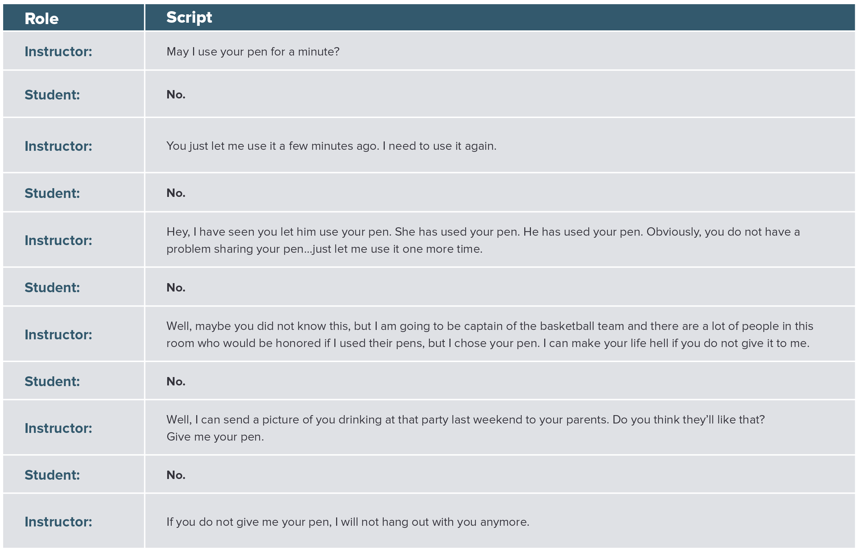
Pressure Role-Play
Notes:
Facilitator Guide: Page 67
Handbook: Page 21

Slide 71
Pressure Role-Play
What type of pressure was used?
How could this type of pressure be used in a sexual situation?
Pressure– especially emotional pressure– can be very subtle. But that does not make it okay.
Remember: When used in a sexual situation, this is still sexual violence!
Notes:
Facilitator Guide: Page 68
Handbook: Page 21

Slide 72
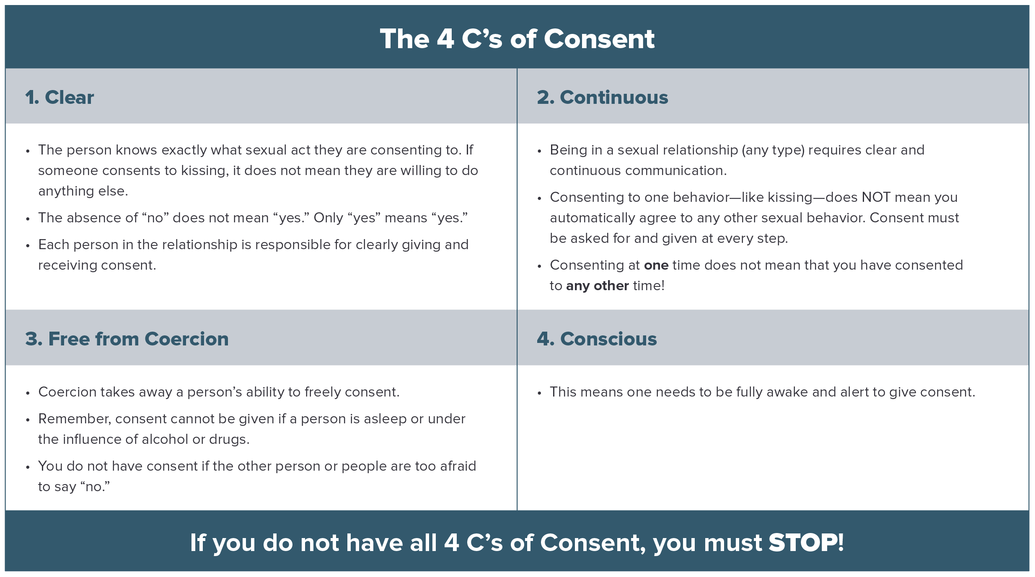
The 4 C’s of Consent
Notes:
Facilitator Guide: Page 70
Handbook: Page 22

Slide 73
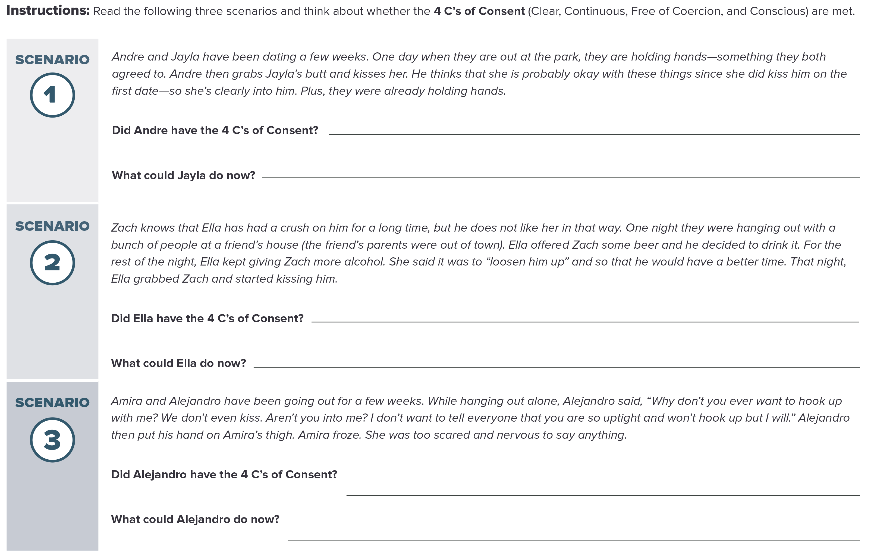
Consent Checklist
Notes:
Facilitator Guide: Page 71
Handbook: Page 23

Slide 74
Dating Safety Tips
Think about your own limits regarding sexual contact.
Do things in groups (dates or hanging out with someone for the first time).
Look out for your friends.
Tell someone (a parent, a trusted adult, a friend) the 4 Ws when you go out:
  WHO you are going with
  WHERE you are going
  WHAT you are doing
  WHEN you will be home
Notes:
Facilitator Guide: Page 73
Handbook: Page 24

Slide 75
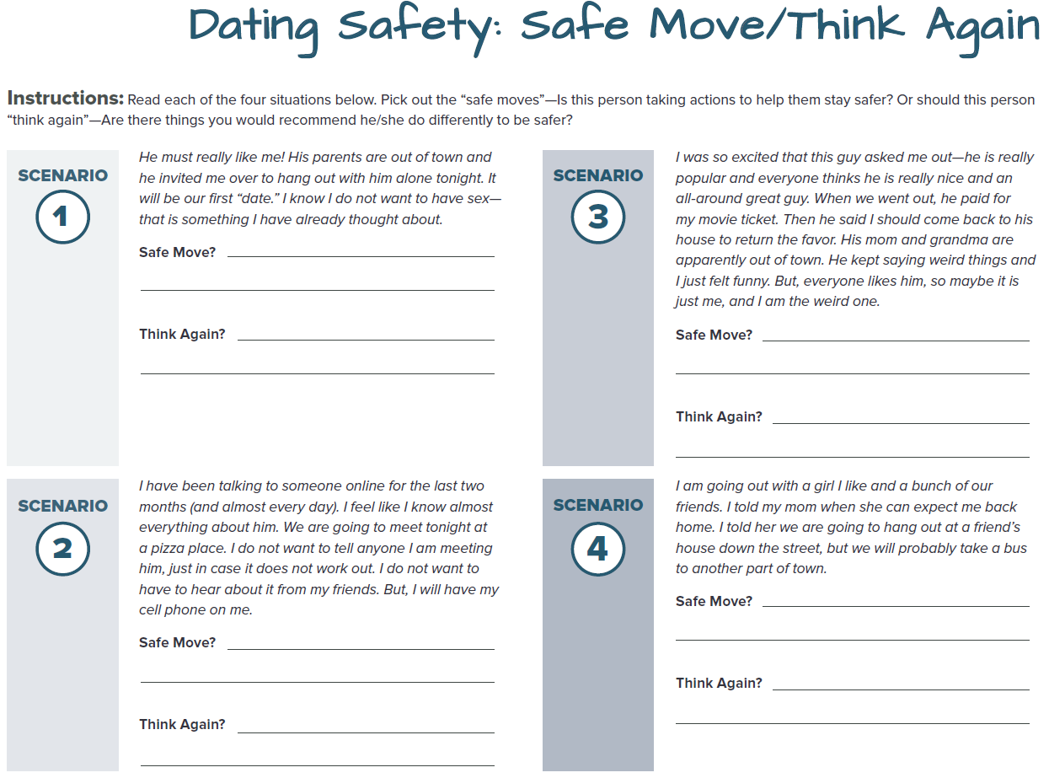
Safe Move or Think Again?
Notes:
Facilitator Guide: Page 74
Handbook: Page 25

Slide 76
Safe Move or Think Again?
Notes:
Facilitator Guide: Page 74
Handbook: Page 25

Slide 77
Safe Move or Think Again?
Notes:
Facilitator Guide: Page 74
Handbook: Page 25

Slide 78
Safe Move or Think Again?
Notes:
Facilitator Guide: Page 74
Handbook: Page 25

Slide 79
Recap & Preview
Session 6:
Sexual violence and dating safety
Consent
Session 7:
Getting help and helping friends
RESPECT ME Rights
Parking Lot discussions
Notes:
Facilitator Guide: Page 75

Slide 80

Session 7: Relationship Rights & Getting Help
Notes:
Facilitator Guide: Page 77

Slide 81
Question of the Day
True or False? Most teenagers that experience dating violence usually do not tell anyone they were being hurt.
Notes:
Facilitator Guide: Page 78
Use polling function for this QOD.

Slide 82
True
Most teens involved in dating violence do not tell their parents.
The longer the young person has been in the relationship, the less likely it is that they will report the abuse.
Notes:
Facilitator Guide: Page 78

Slide 83
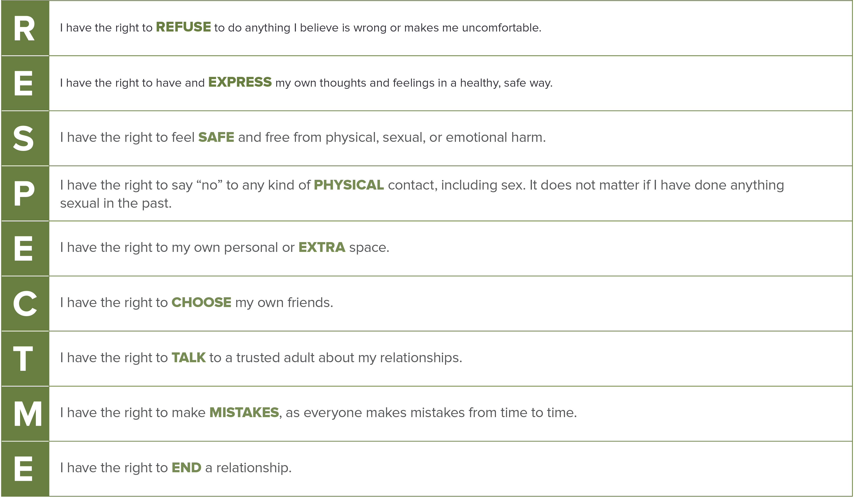
RESPECT ME Rights
Notes:
Facilitator Guide: Page 83
Handbook: Page 32

Slide 84
Helping Friends
Reach out
Listen
Believe
Do not judge
Repeat that violence or abuse is not their fault
Connect them to a resource that can help
Notes:
Handbook: Page 34

Slide 85
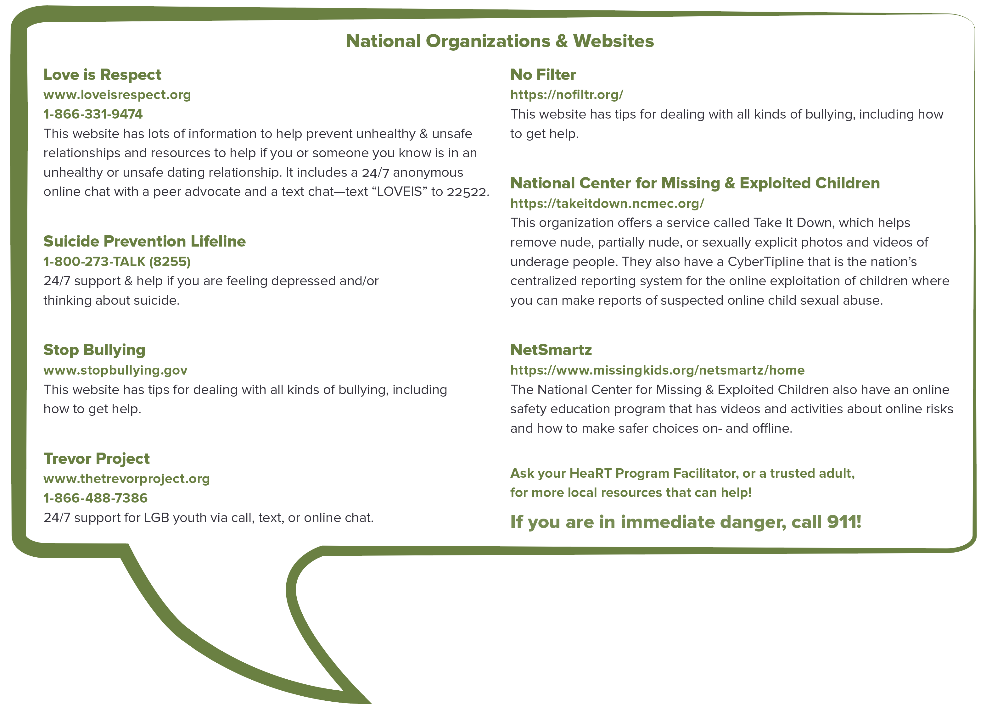
Where Can I or My Friends Get Help?
Notes:
Facilitator Guide: Page 85
Handbook: Page 35

Slide 86
RESPECT ME Rights Rewind
Each group or individual will have the rest of the class time to create a piece of artwork (on your computer or on a blank piece of paper) that focuses on one of the RESPECT ME Rights.
For example: you can write a poem, draw a picture or comic, cut out pictures from magazines, “cut and paste” images online onto a slide or Word doc.
Each group/individual will have 5 mins to perform/present in the next class
Notes:
Facilitator Guide: Page 86

Slide 87
Parking Lot
[insert topic for later discussion]
[insert topic for later discussion]
[insert topic for later discussion]
[insert topic for later discussion]
[insert topic for later discussion]
[insert topic for later discussion]
[insert topic for later discussion]
[insert topic for later discussion]
Notes:
Handbook: Page 36
Copy and paste your filled out parking lot slide in place of this placeholder slide.

Slide 88
CONGRATULATIONS!!!

